Slide 1
Time-of-Use Electricity Pricing: Implications of Hawaiʻi’s Pilot Program

Slide 2
Research Questions
Which households or customer groups are likely to come out ahead, and who may see bill increases due to the pilot program?
What consumption characteristics are common among customers who win, and those who lose?
How can customers benefit from time-of-use pricing?

Slide 3
Related Literature
The Long-Run Efficiency of Real-Time Electricity Pricing
Borenstein (2005)
Time-of-Use Rates and Real-Time Prices
Hogan (2014)
Real-Time Pricing and the Cost of Clean Power
Imelda, Fripp, & Roberts (2023)
Knowledge Is (Less) Power: Experimental Evidence from Residential Energy Use
Jessoe & Rapson (2014)

Slide 4
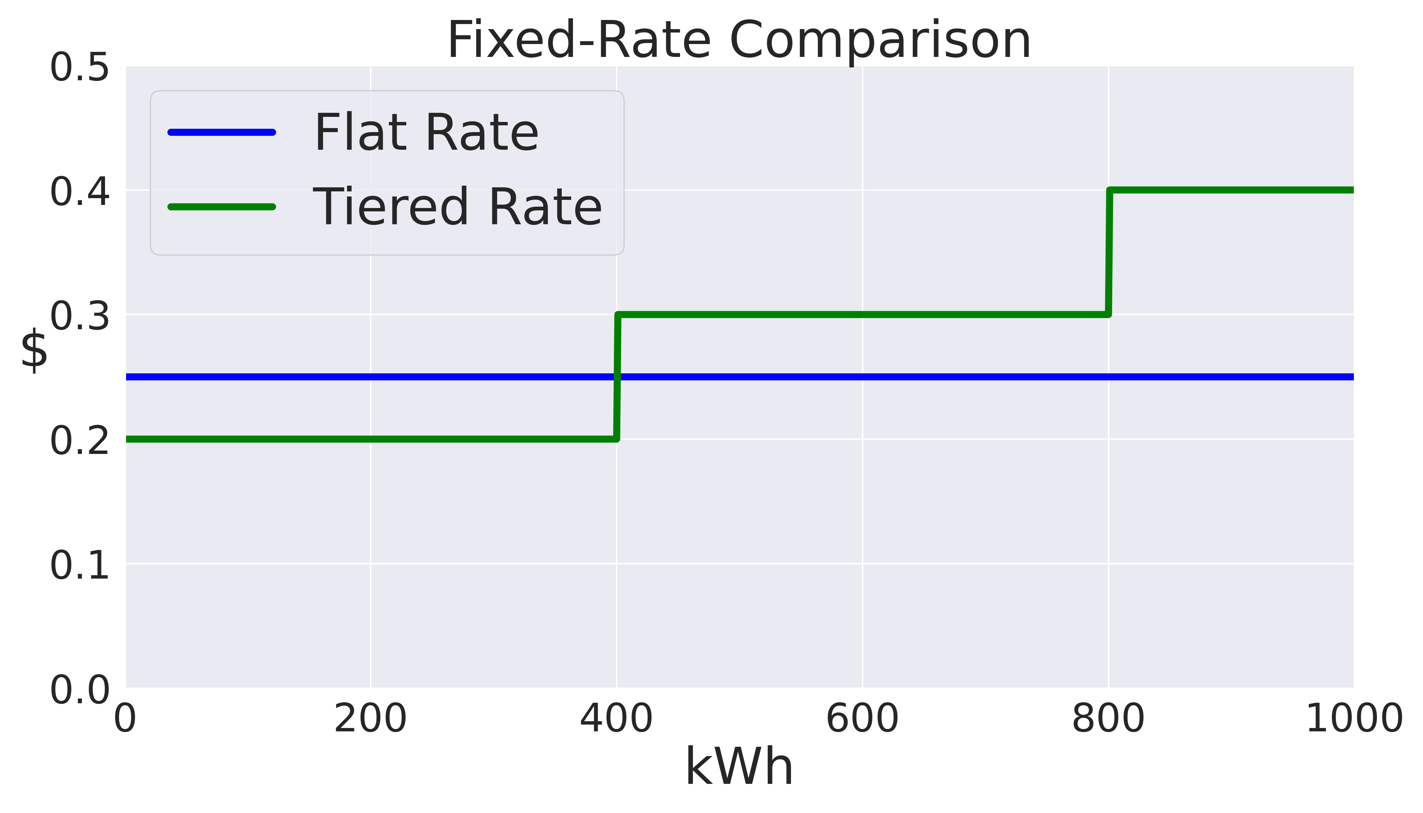
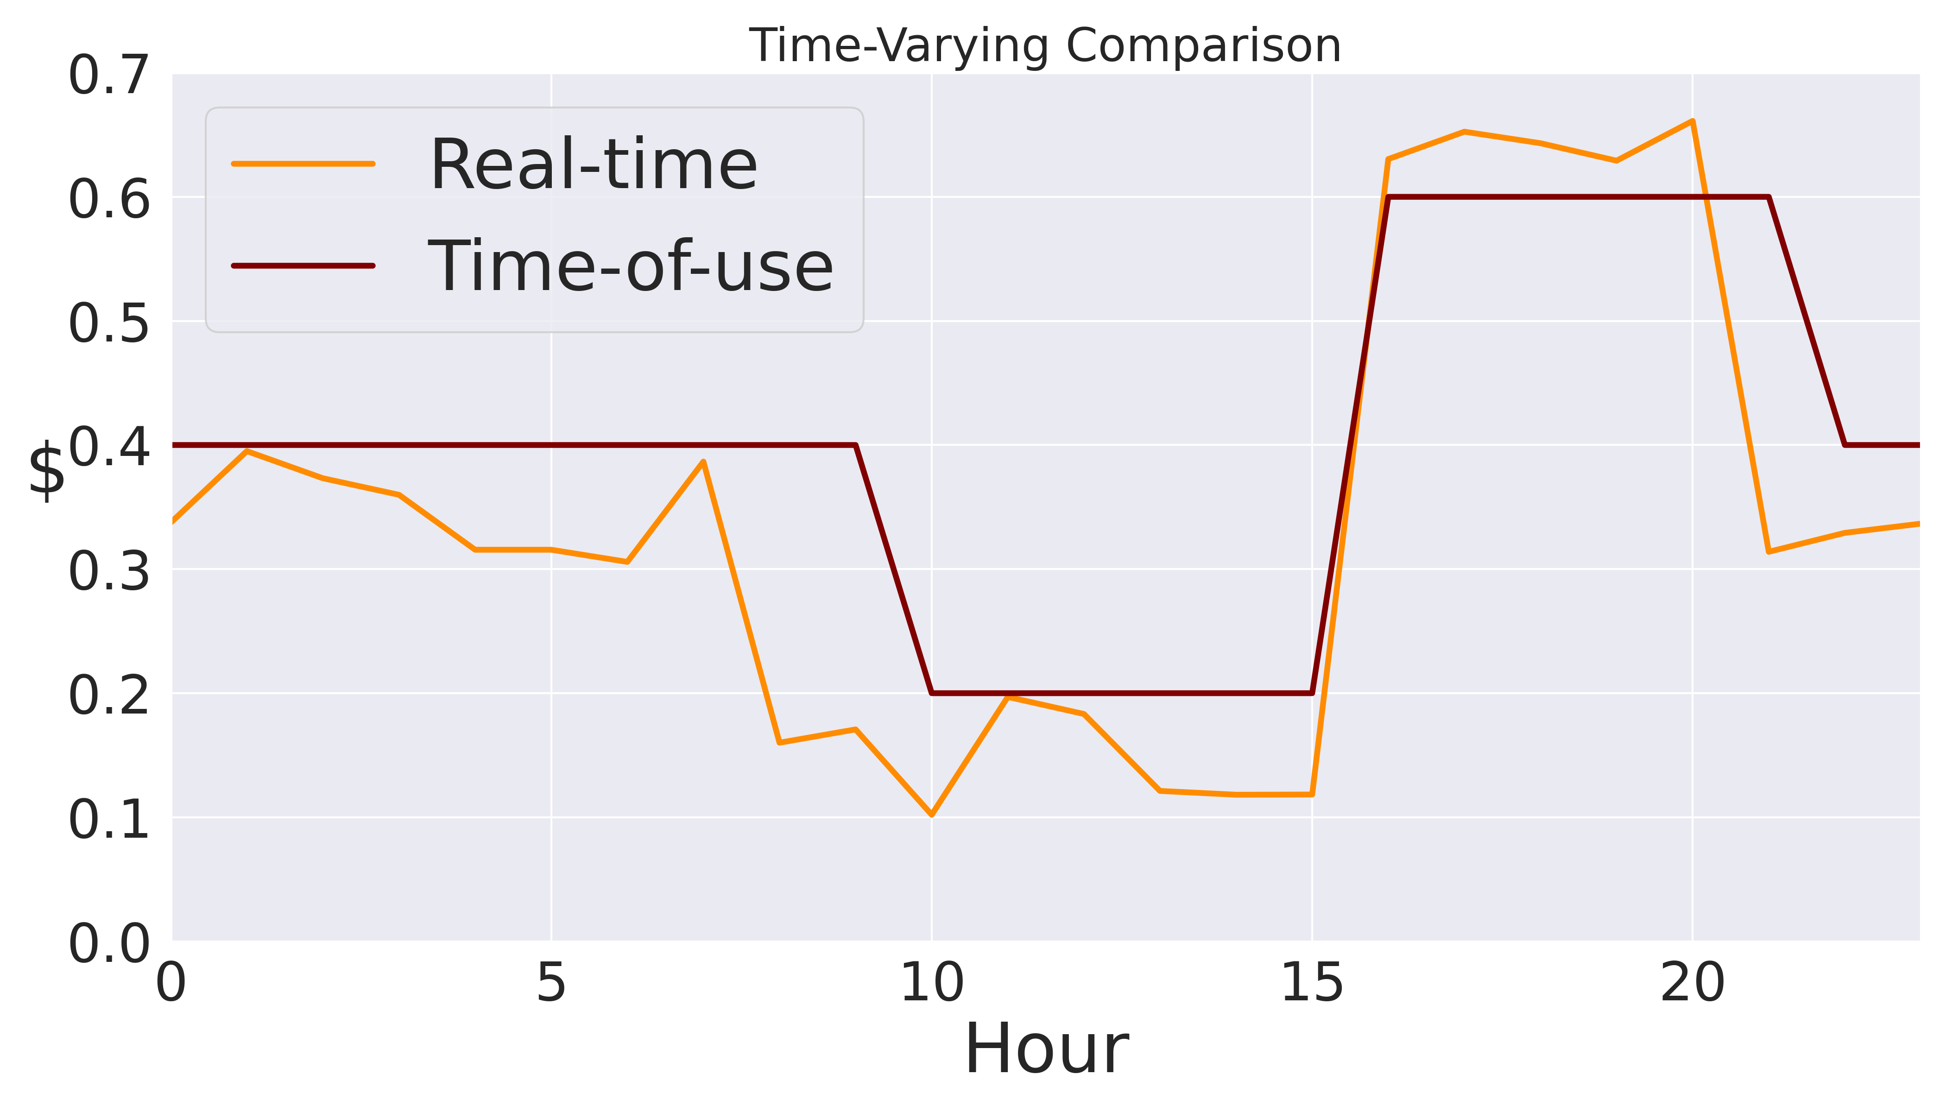
Energy Pricing
Fixed-rate
Flat rate
The price per kWh is constant regardless of amount consumed or time of consumption.
Tiered rate
Prices remain constant over time but fluctuate based on usage levels.
Time-varying pricing
Real-time pricing (RTP)
The prices customers face mirrors the underlying wholesale electricity market or cost of production.
Time-of-use pricing (TOU)
A simple implementation of time-varying pricing in which prices move at set times to set values throughout the day.

Slide 5
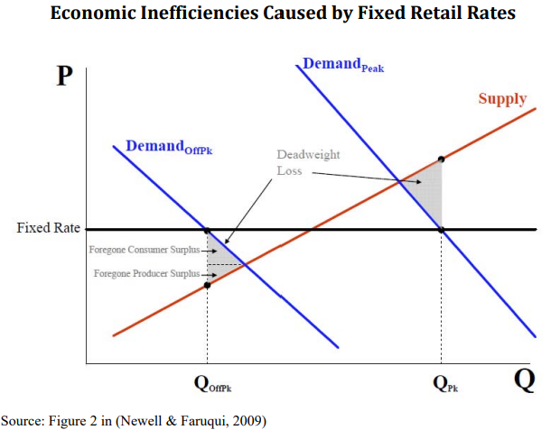
Variable Pricing

Slide 6
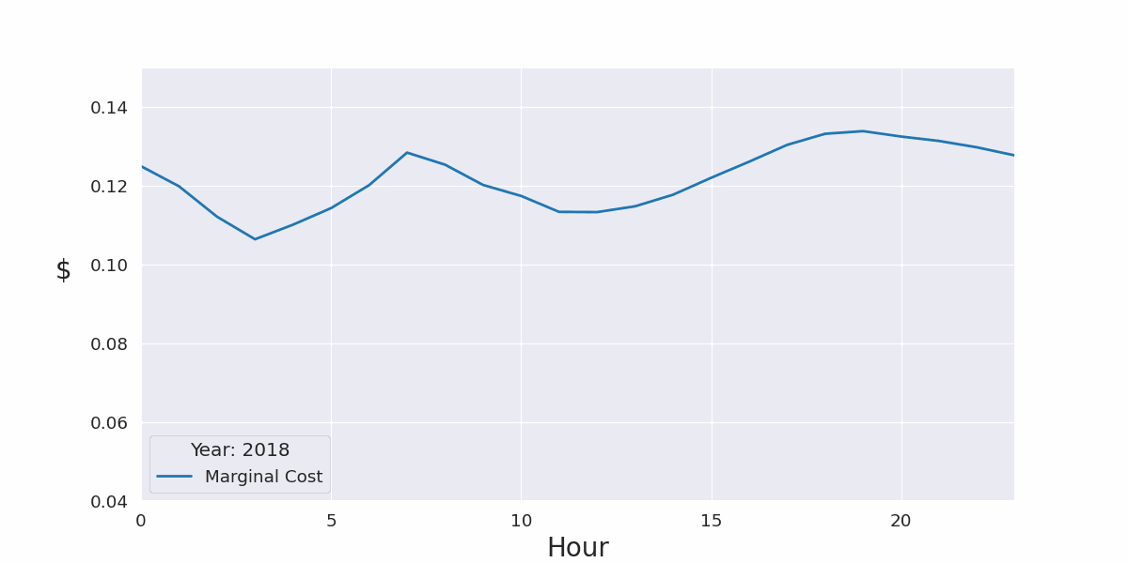
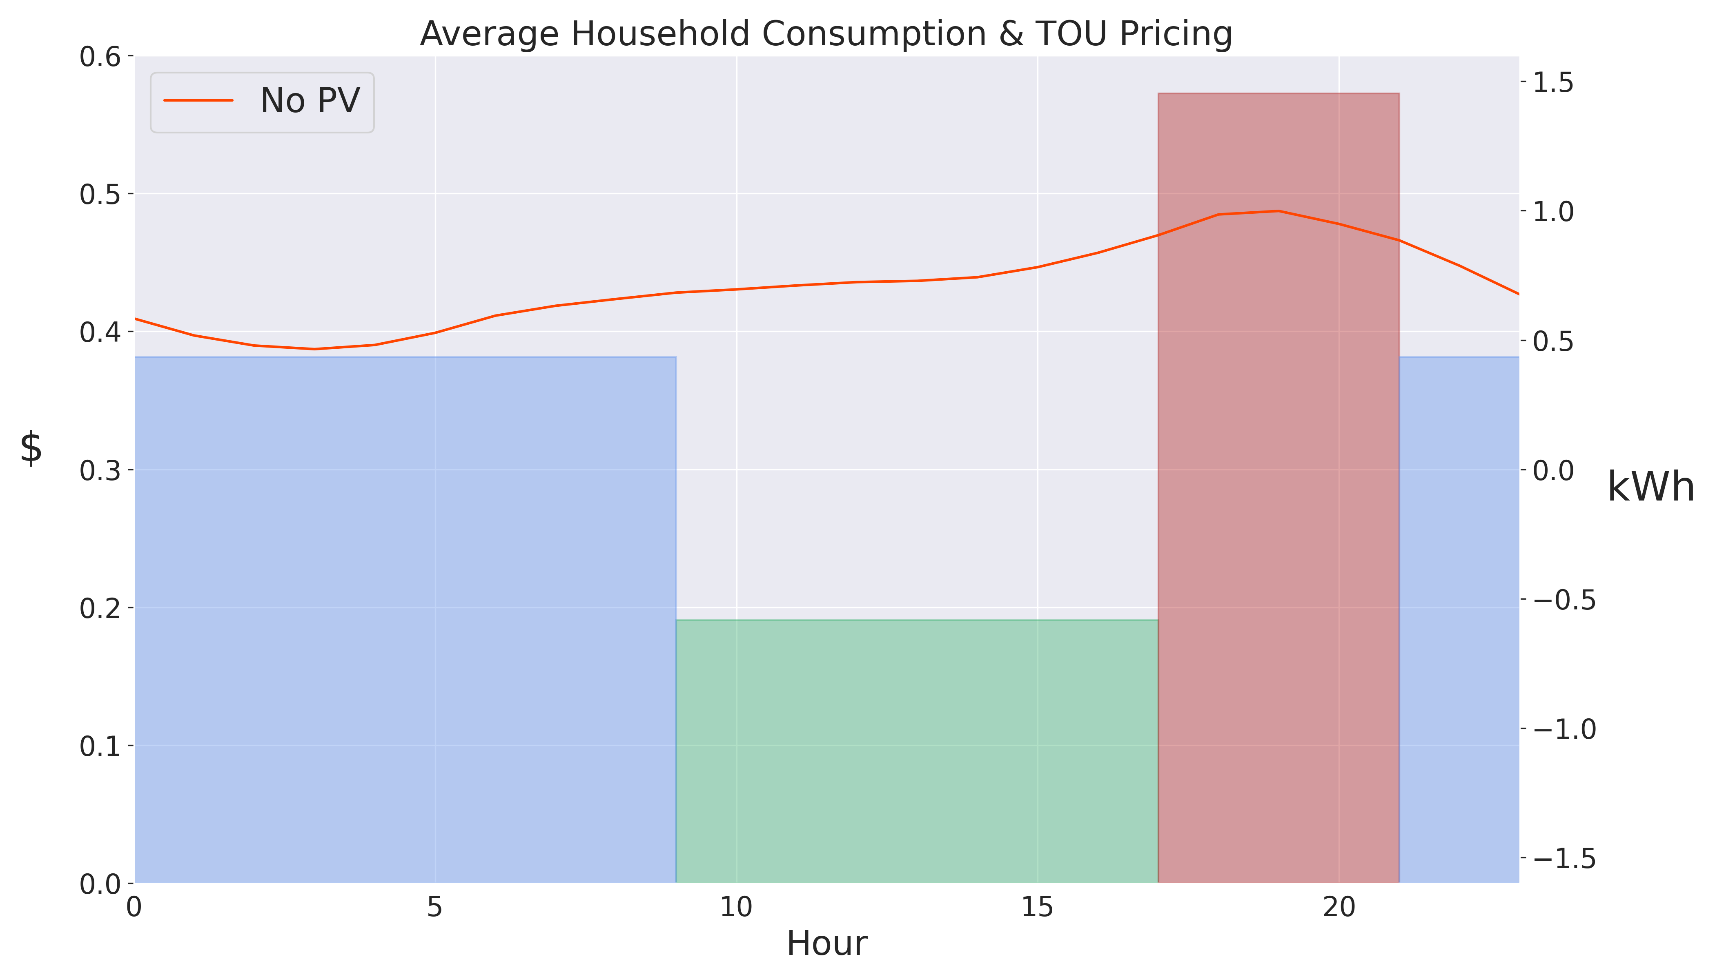
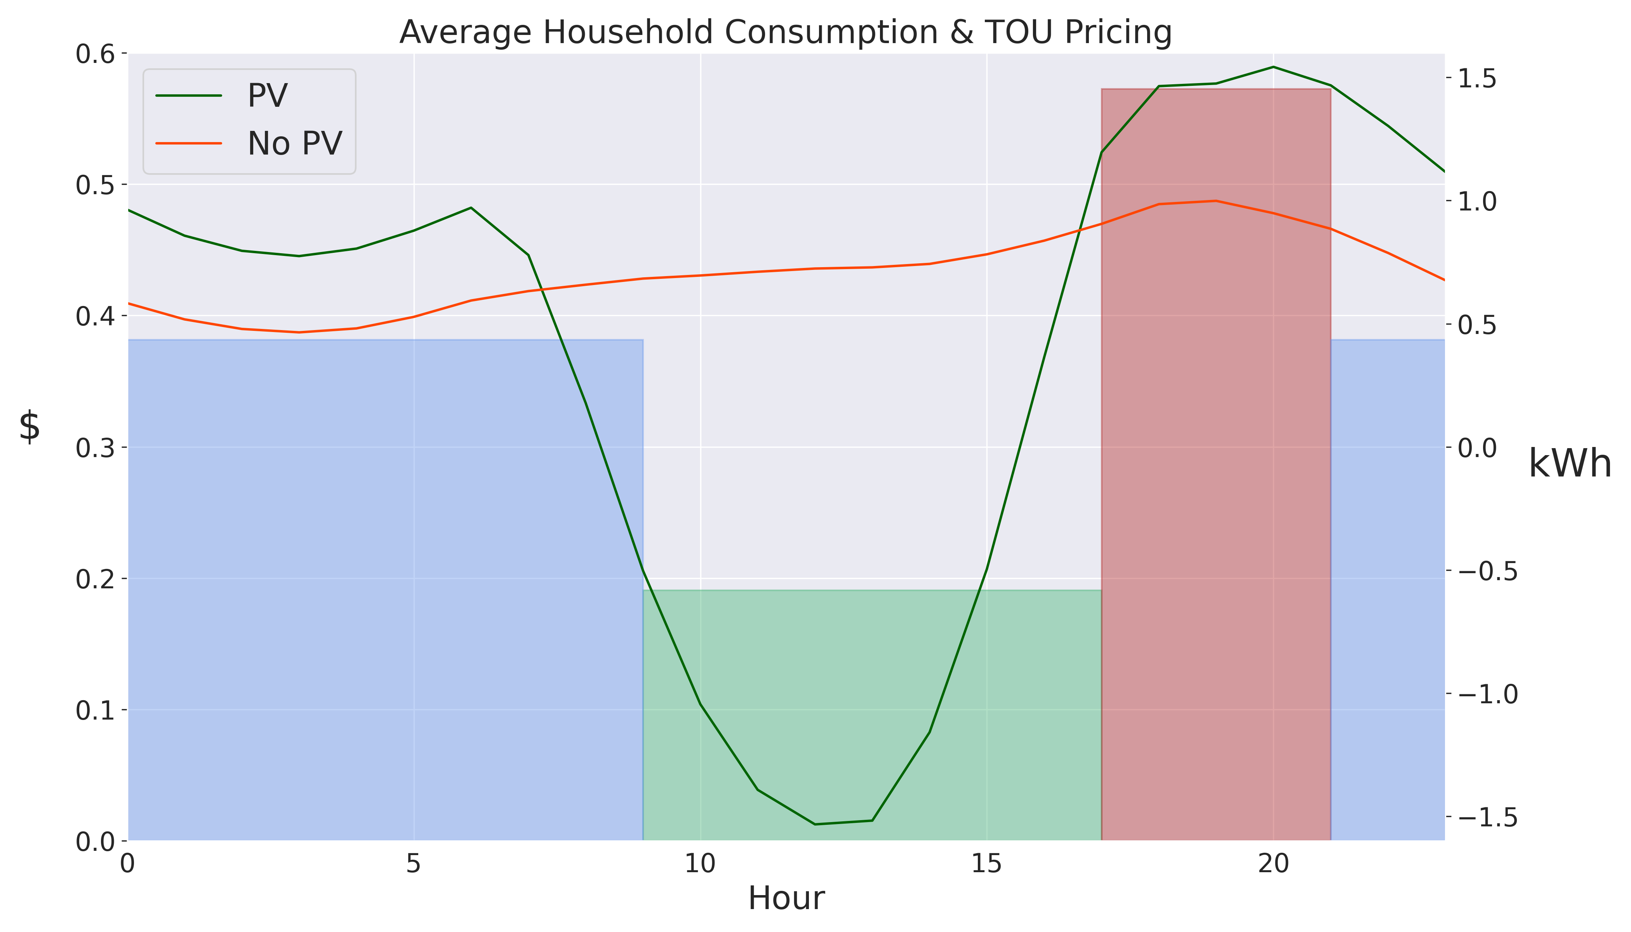
Variable Pricing
Efficient Pricing
Demand Shifting: Win-Win

Slide 7
HECO Effective Rates

Slide 8
Solar PV & Battery Bonus
Battery Bonus Program
Initial incentive: $850 per kW of installed capacity
A 15 kWh battery can commit 5kW to the grid over the two-hour discharge period making the one-time payment $850 x 5 kW = $4,250.
Customers not in the NEM program receive a monthly credit for the first three years at the retail rate for electricity during the two-hour discharge period.
Customers receive a $5 per KW monthly peak capacity payment for the 10-year duration of the program.

Slide 9
Shift & Save
Program Details
The 1-year pilot takes effect 10/1/23.
Customers will receive a bill protection credit for the first six months.
Selected customers are automatically enrolled with the ability to opt-out at any time.
Sampling
Stratified by island and selected randomly within the AMI population.
15,000 residential customers
Oversampling of Solar PV households (40% of total sample)
1,700 commercial customers

Slide 10
HECO AMI Data
Features
15 Minute Meter Measurements
kWh imported & exported
Solar PV Status
Solar PV Program
Observation Location (Census Tract)
Summary (March 2023)
Unique Households: 105k
Solar PV Households: 23%
Unique Census Tracts: 188
AMI Data are provided by Hawaiian Electric Company

Slide 11
Residential (R) Billing Impacts (10/22 – 3/23)

Slide 12
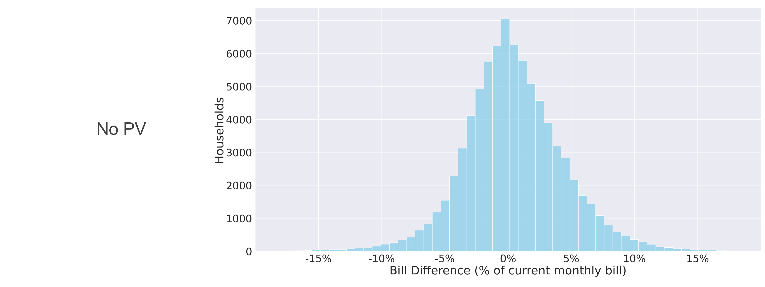
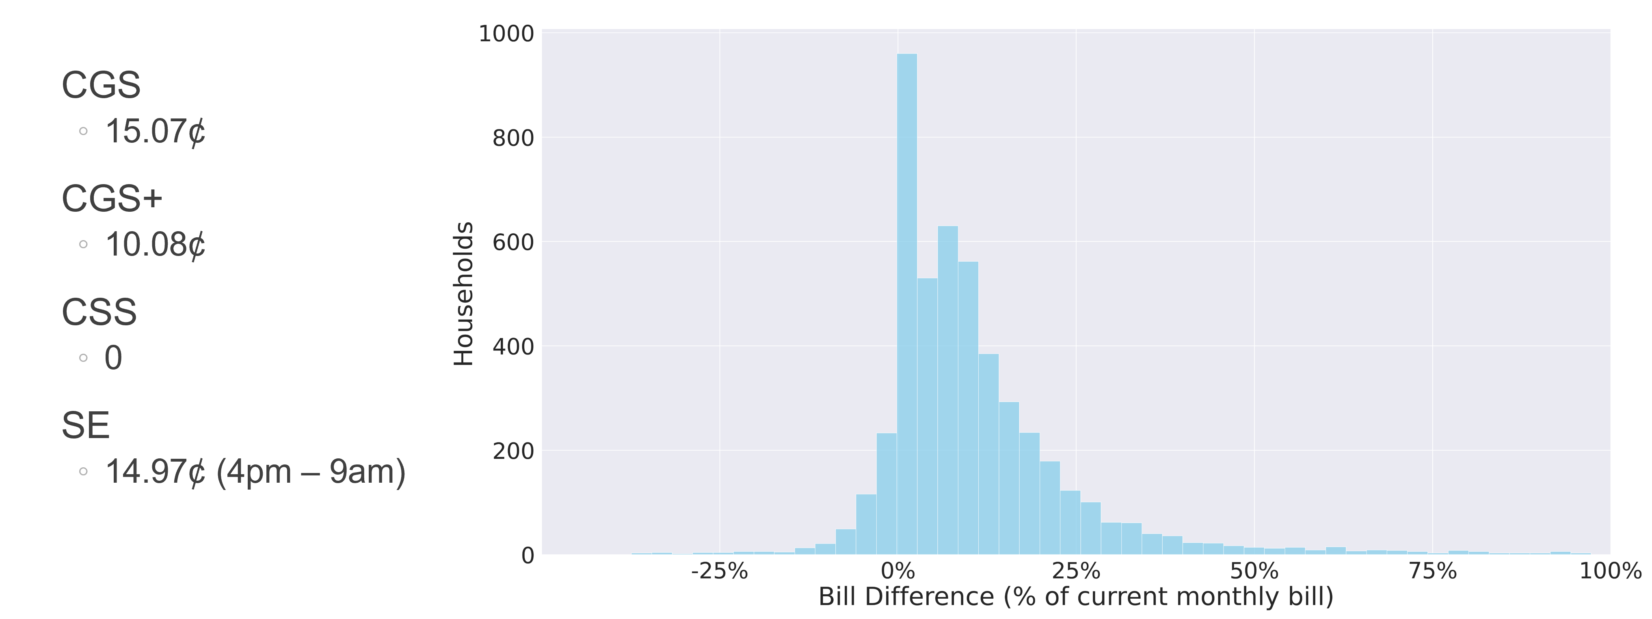
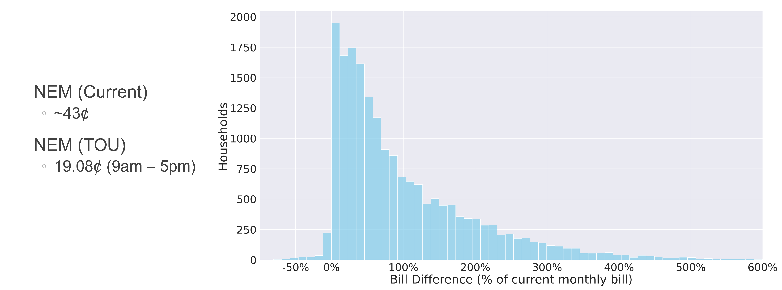
Residential (R) Mean Billing Impacts

Slide 13
Further Analysis: Hourly Consumption Summary Data
Features
Hourly Summary Statistics of Imported & Exported kWh
Minimum, Mean, Maximum, & Standard Deviation
Non-PV Households
Losers (Δ > 0)*: 42,505
Big Losers (Δ > 10%): 1,284
Winners (β > 0)**: 37,701
Big Winners (β > 10%): 751
PV Households
Losers (Δ > 0): 21,917
Big Losers (Δ > 100%): 7,175
Winners (β > 0): 838
Big Winners (β > 25%): 82
*Δ represents the mean increase in monthly bill.
**β represents the mean decrease in monthly bill.

Slide 14
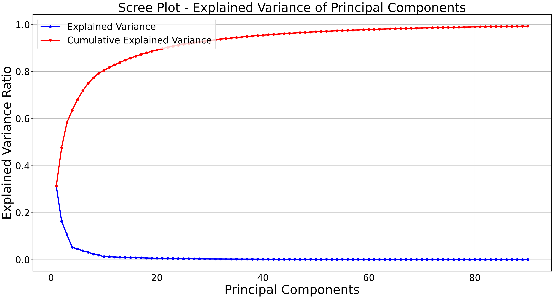
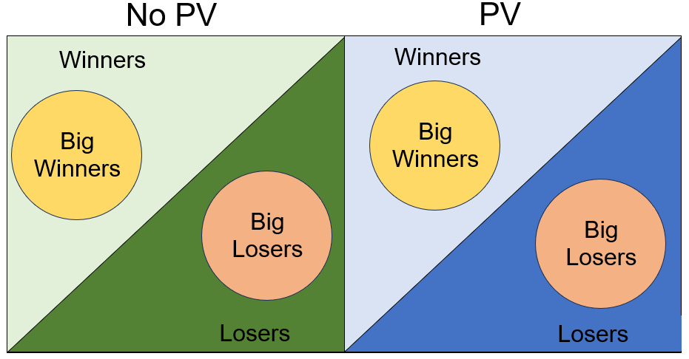
Further Analysis: Methods
Principal Component Analysis (PCA)
PV Households
90 principal components
Non-PV Households
40 principal components
K-Means
Households are clustered within each subgroup:
Non-PV Losers & Non-PV Big Losers
Non-PV Winners & Non-PV Big Winners
PV Losers & PV Big Losers
PV Winners & PV Big Winners

Slide 15
Residential (R) Non-PV Losers
Losers
Big Losers

Slide 16
Residential (R) Non-PV Winners
Winners
Big Winners

Slide 17
Residential (R) PV Losers
Losers
Big Losers

Slide 18
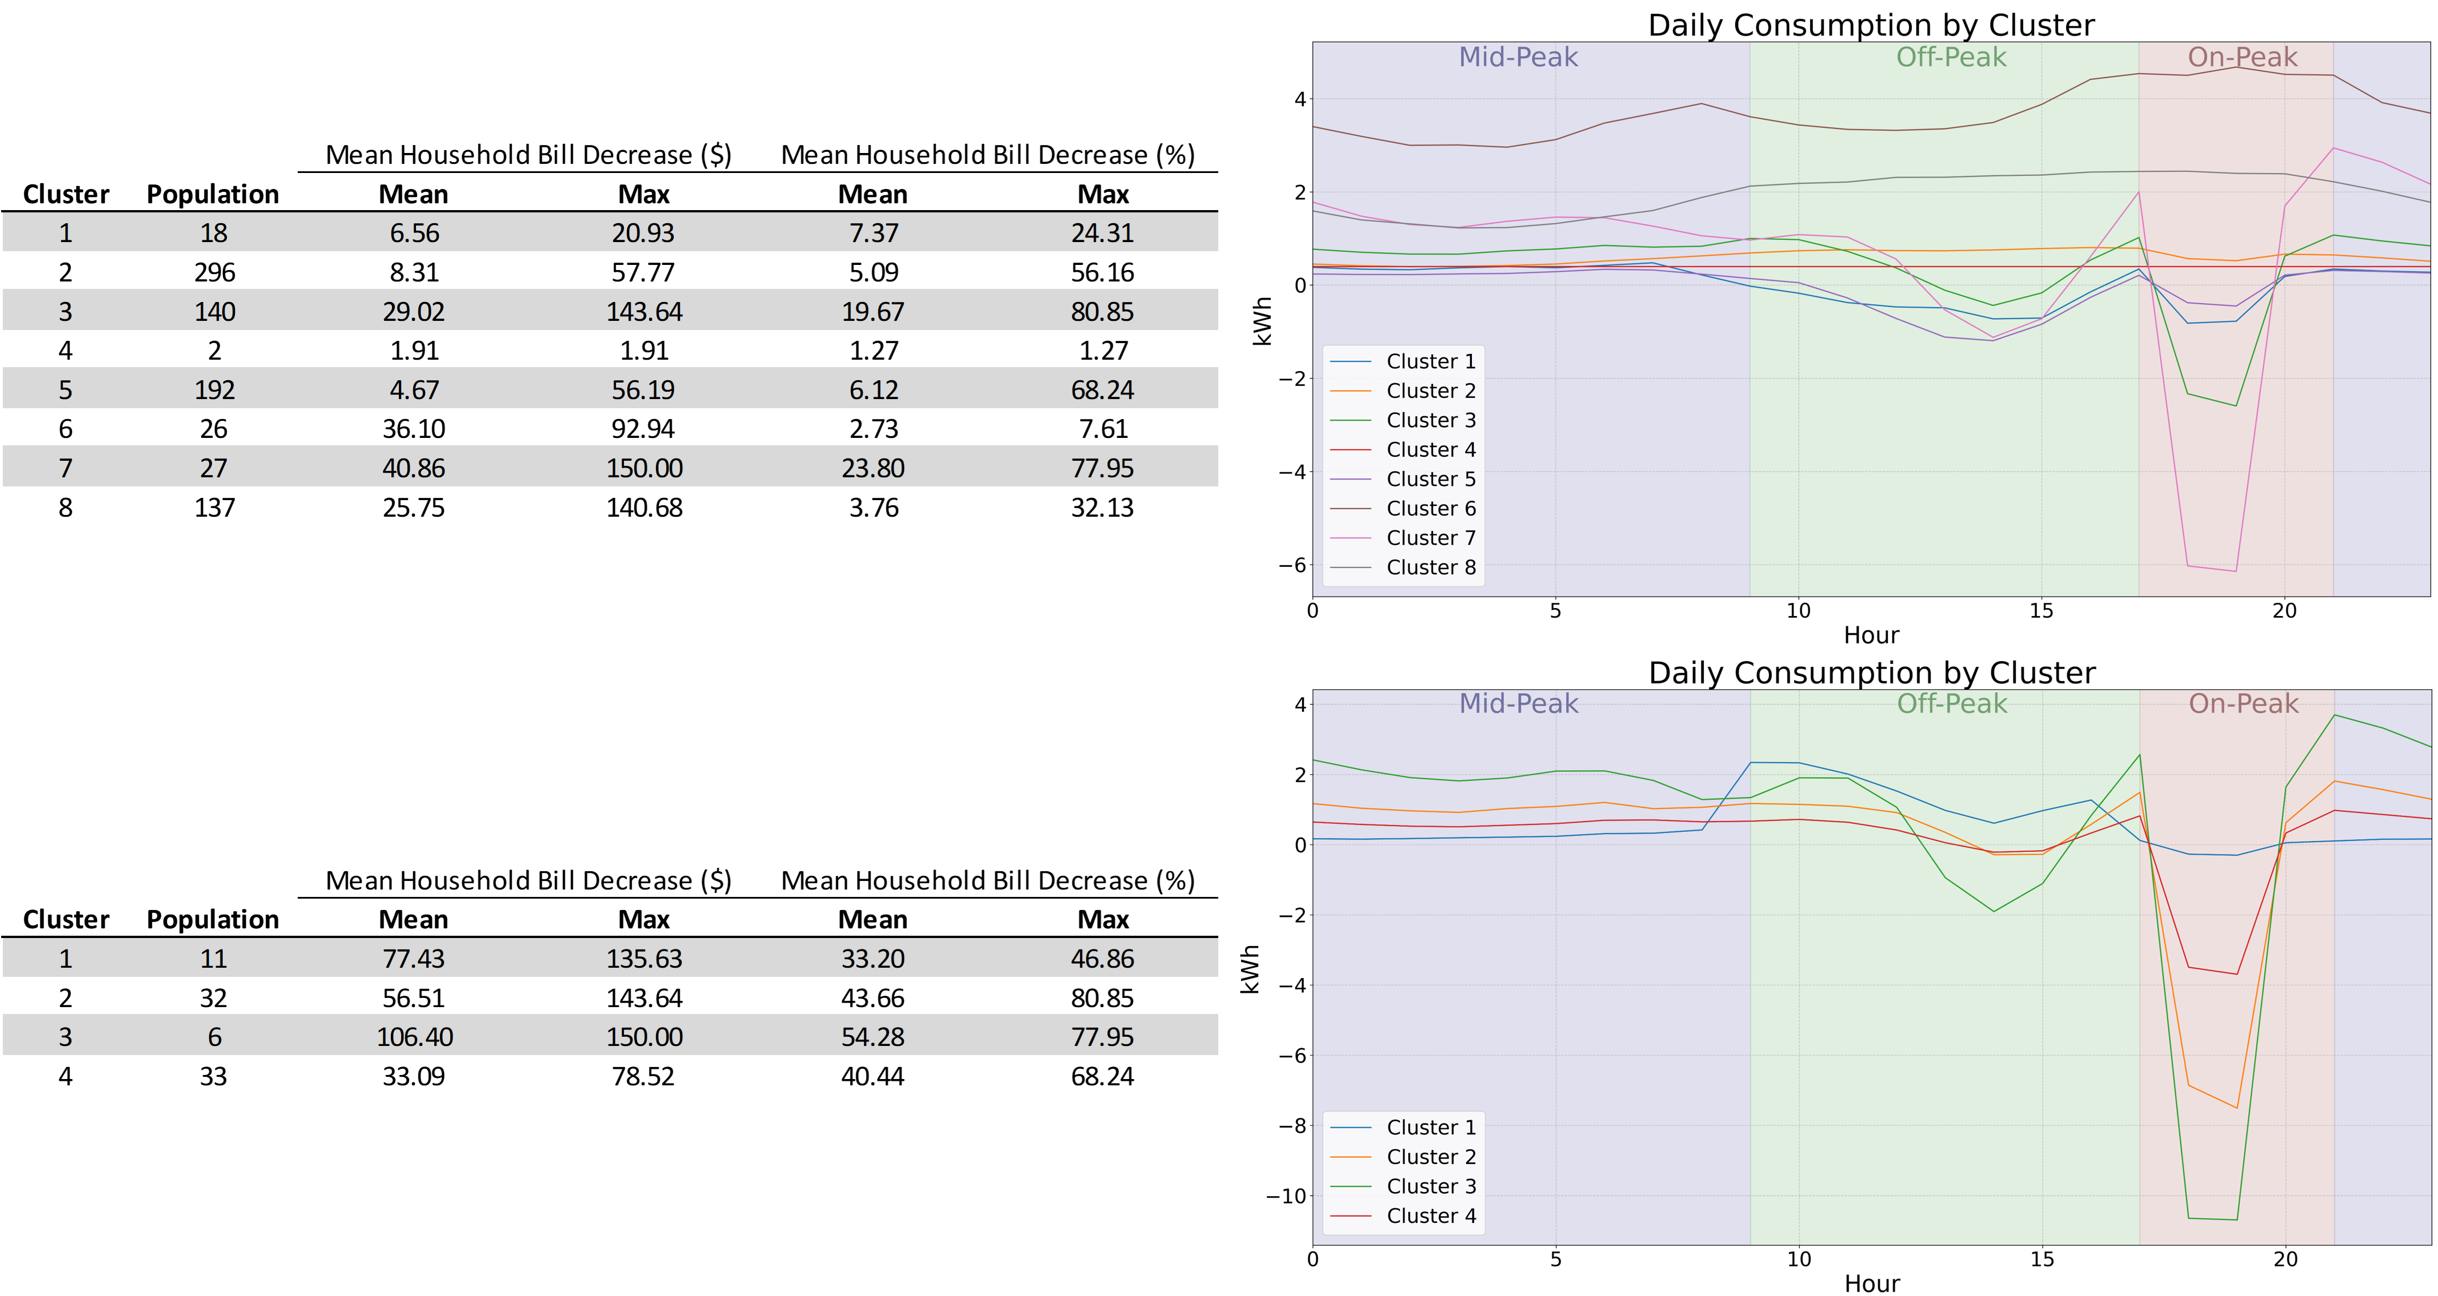
Residential (R) PV Winners
Winners
Big Winners

Slide 19
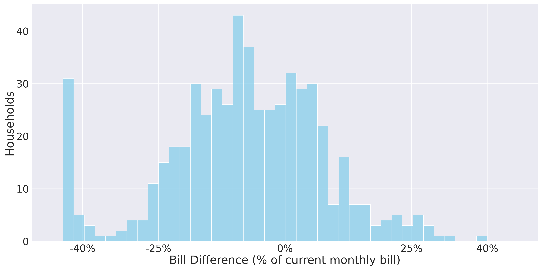
Small Commercial (G) Mean Billing Impacts

Slide 20
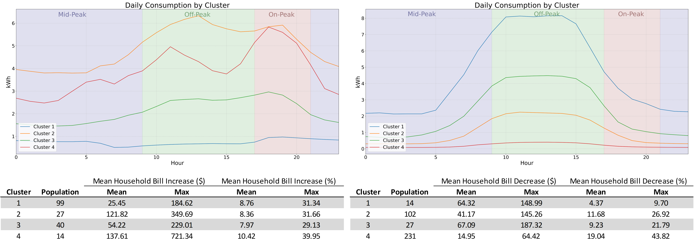
Small Commercial (G) Losers & Winners

Slide 21
How to win: Consumption Shifting (20% On-Peak)
On average, households would need to shift 26 kWh each month equating to roughly 5% of total monthly consumption.
8 laundry cycles (washer & dryer)
15 dishwasher cycles
~1 hour a day of window AC use
Home automation and appliance controllers
The typical monthly consumption for water heaters is approximately 100 kWh, and with the aid of modern appliance controllers, this entire usage can be effectively rescheduled.

Slide 22
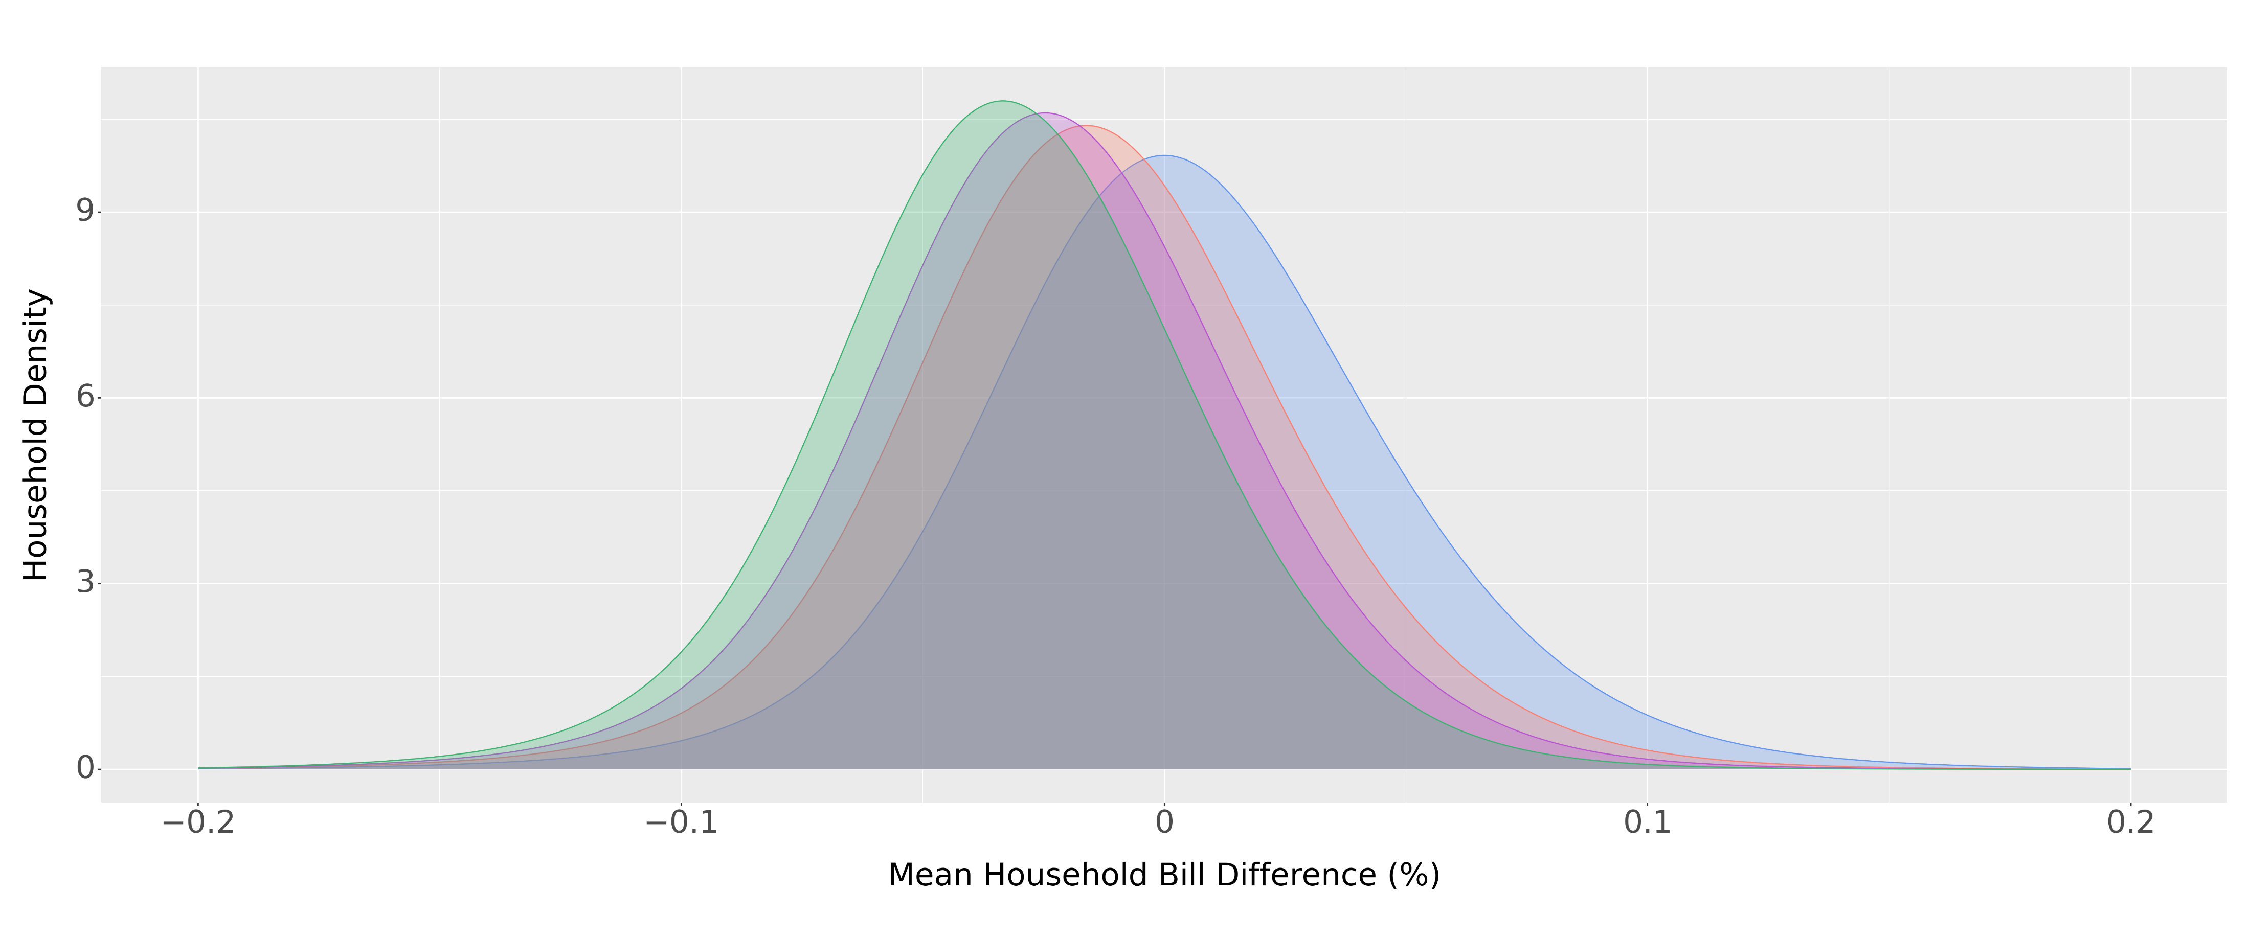
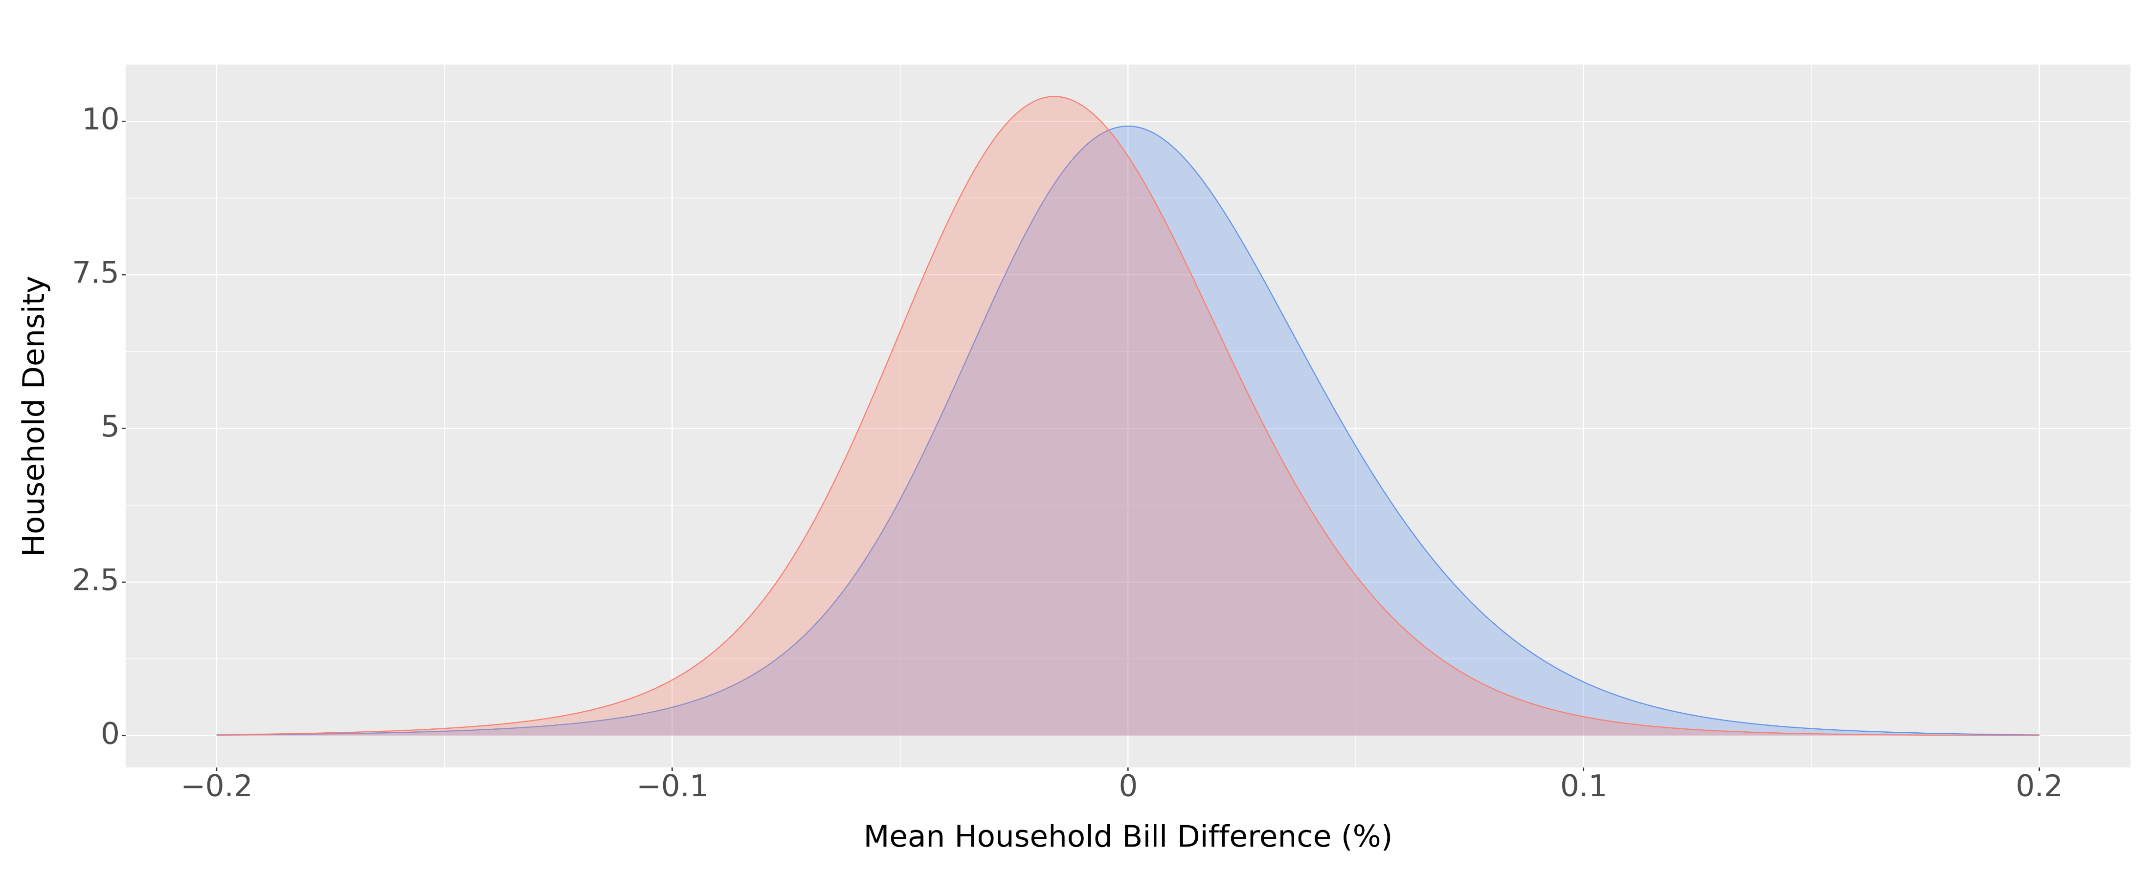
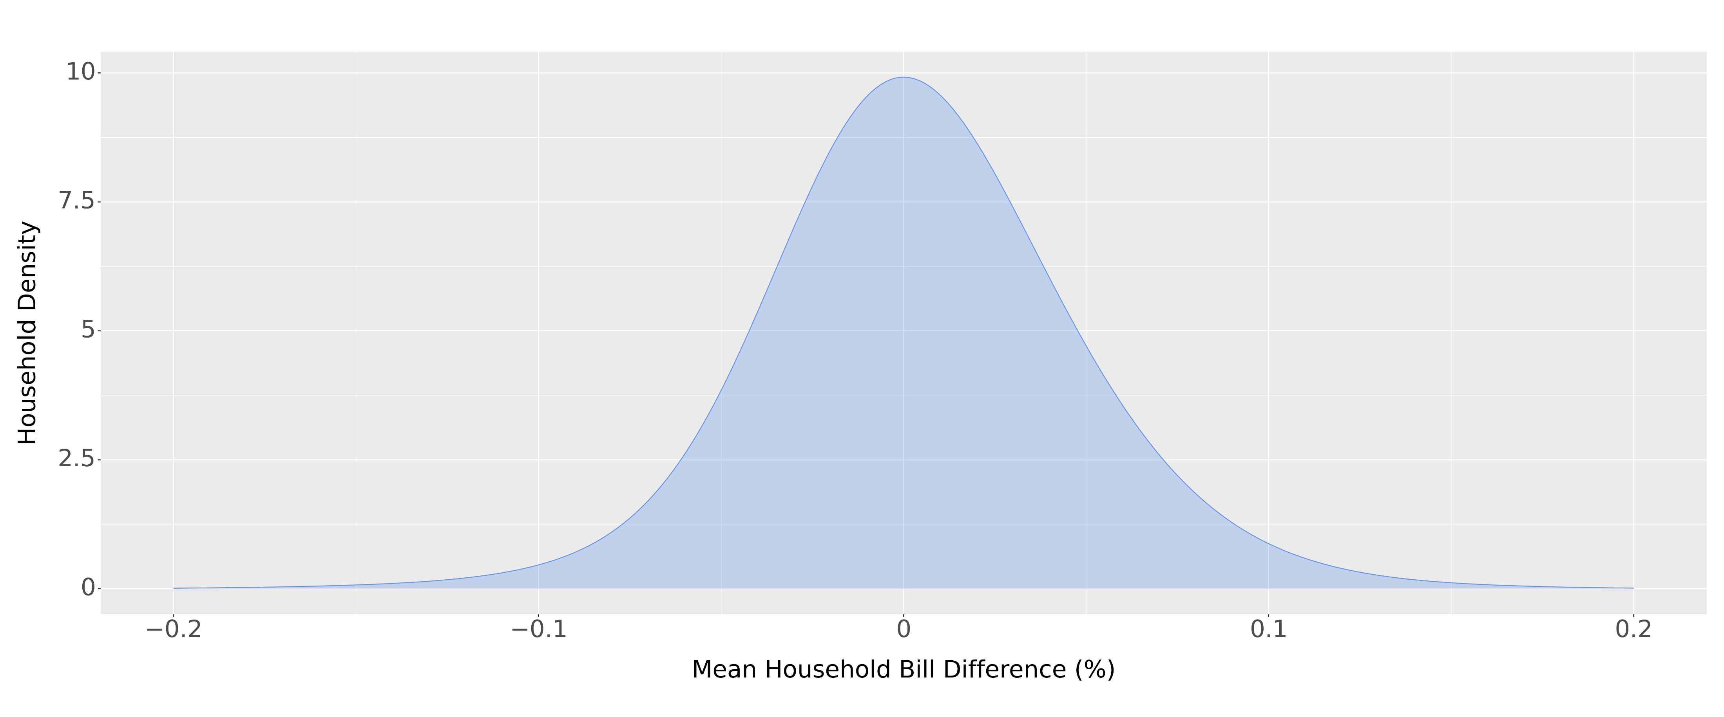
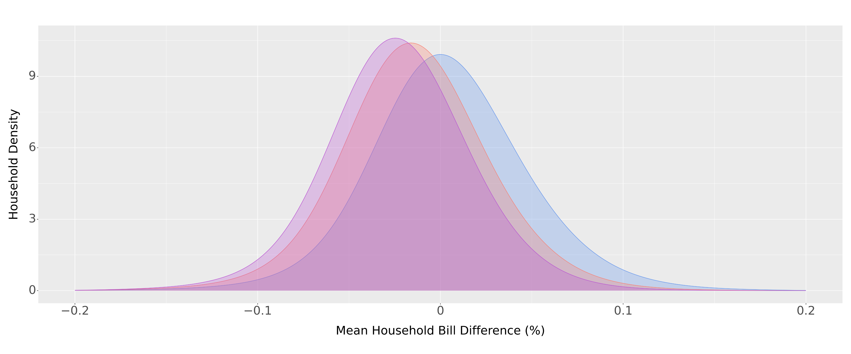
How to Win: Consumption Shifting (No PV)
No Response
20% Shift to Mid-Peak
10% Shift to Mid-Peak & Off-Peak
20% Shift to Off-Peak

Slide 23
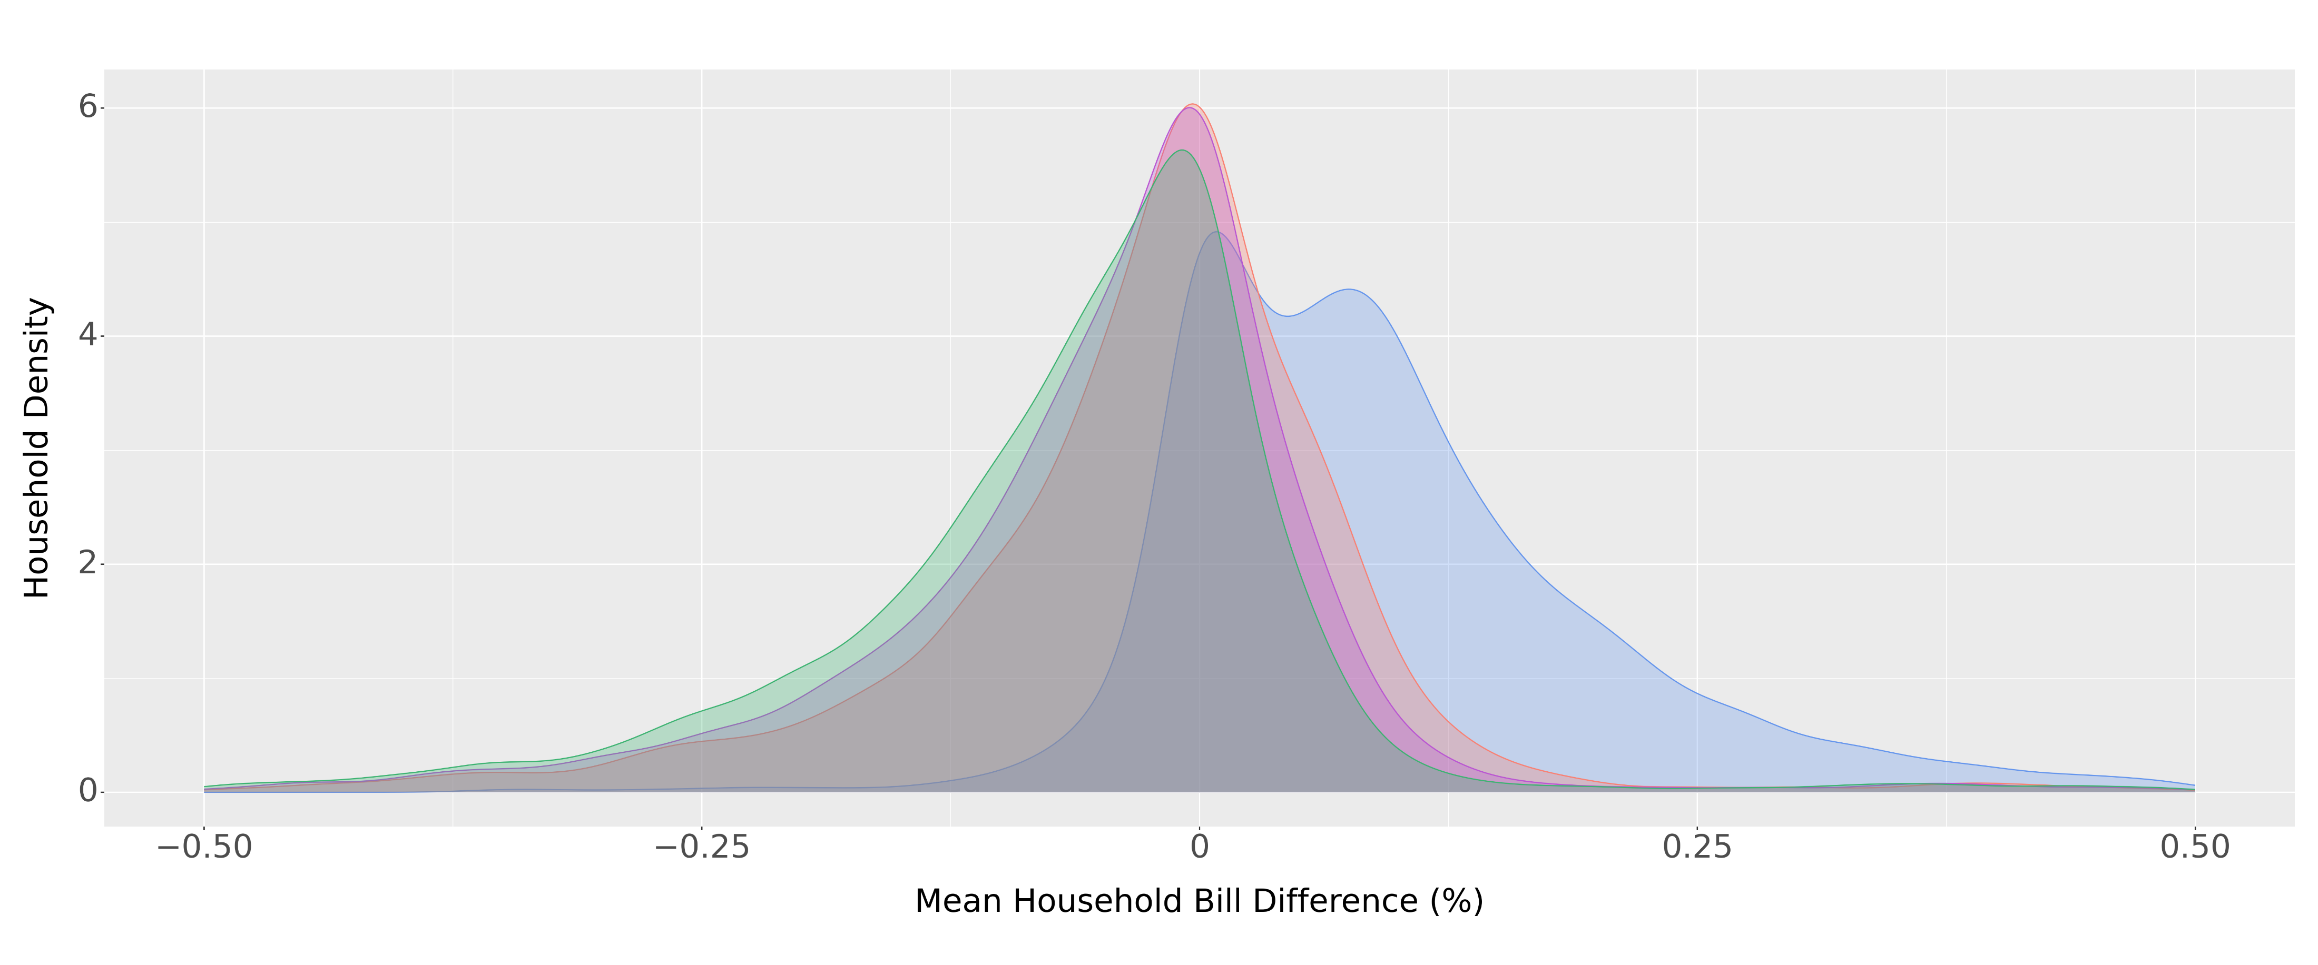
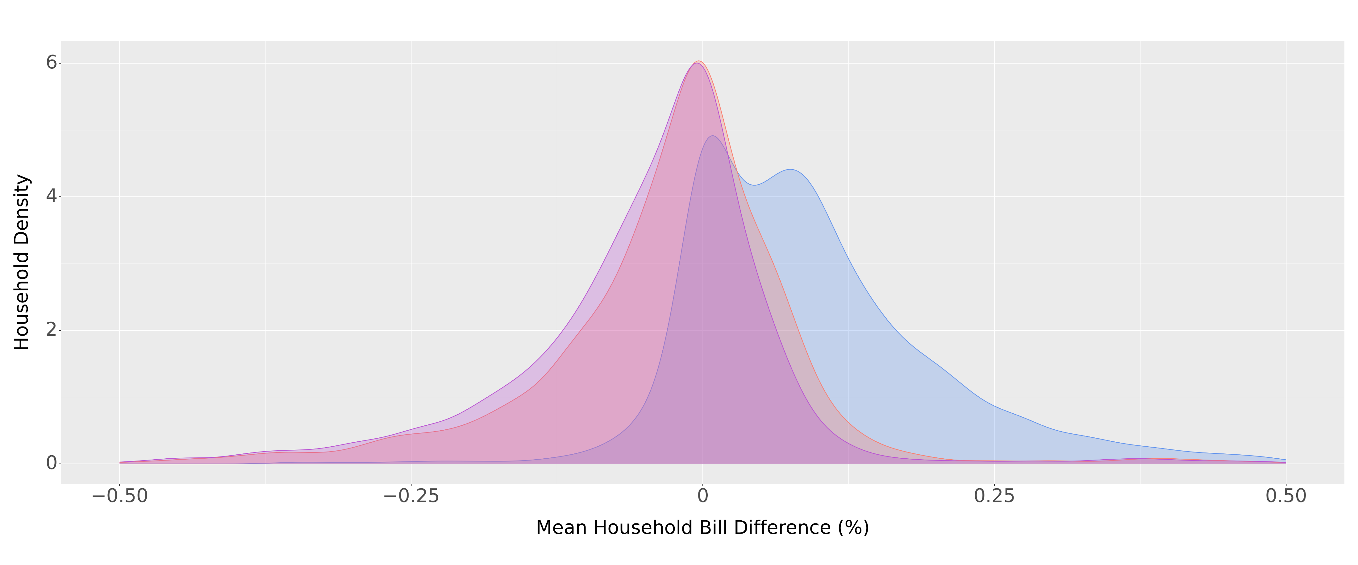
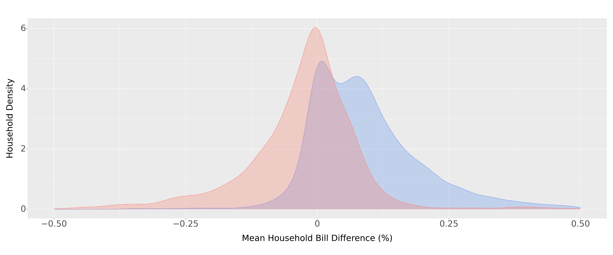
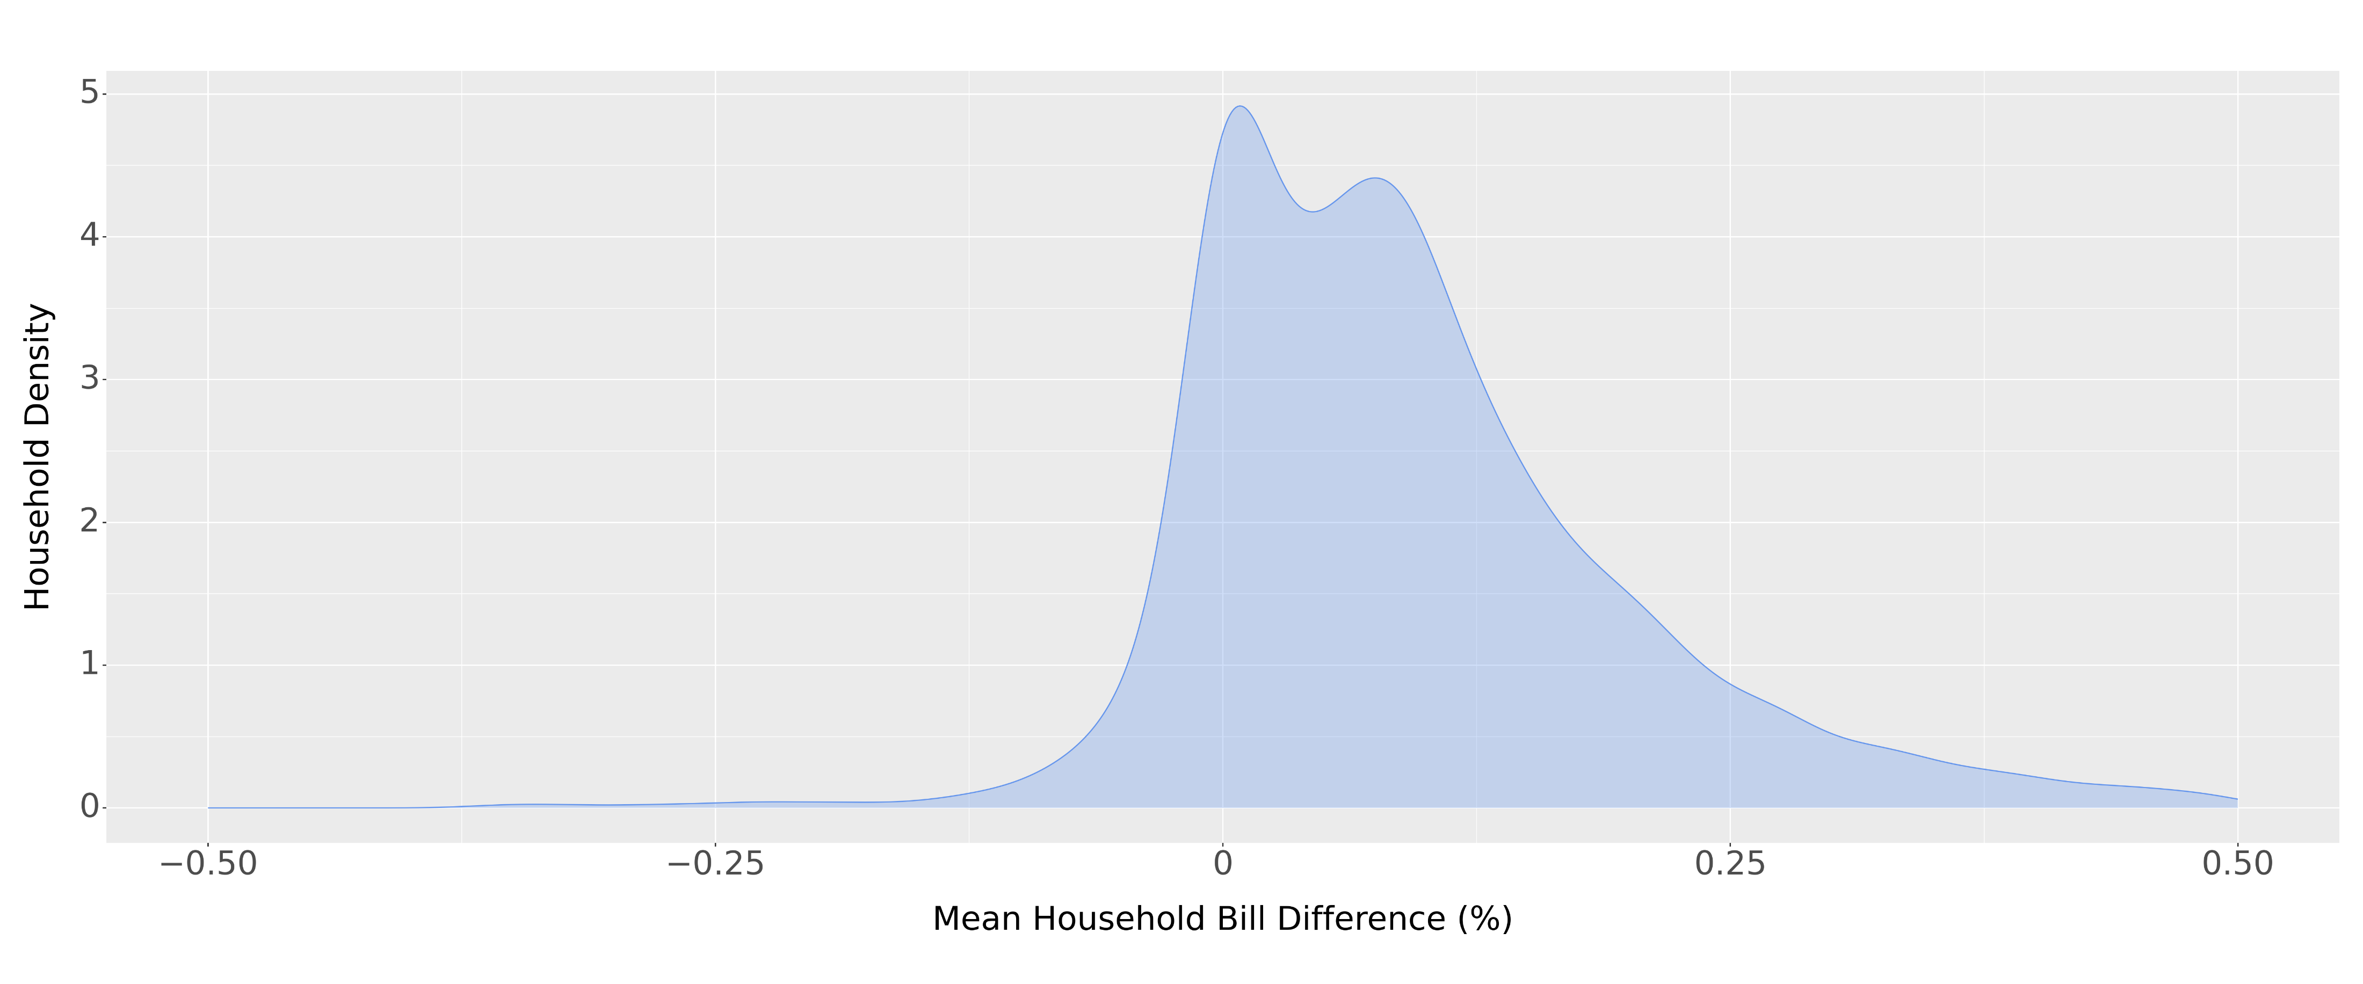
How to Win: Consumption Shifting (Other PV)
No Response
20% Shift to Mid-Peak
10% Shift to Mid-Peak & Off-Peak
20% Shift to Off-Peak

Slide 24
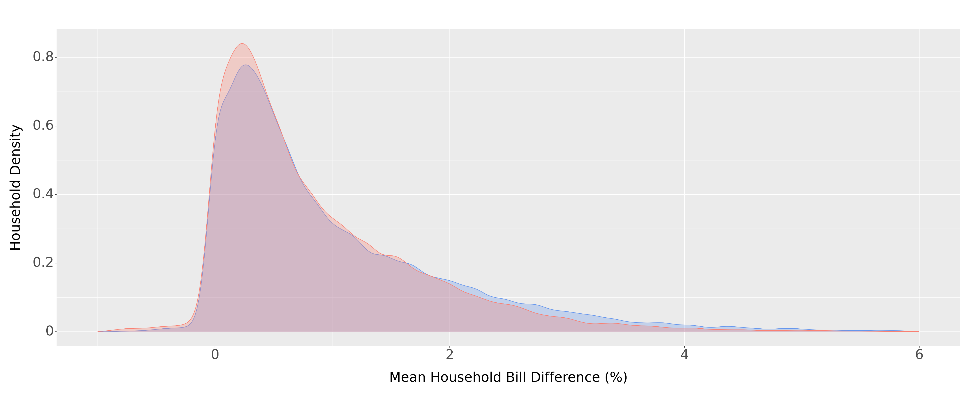
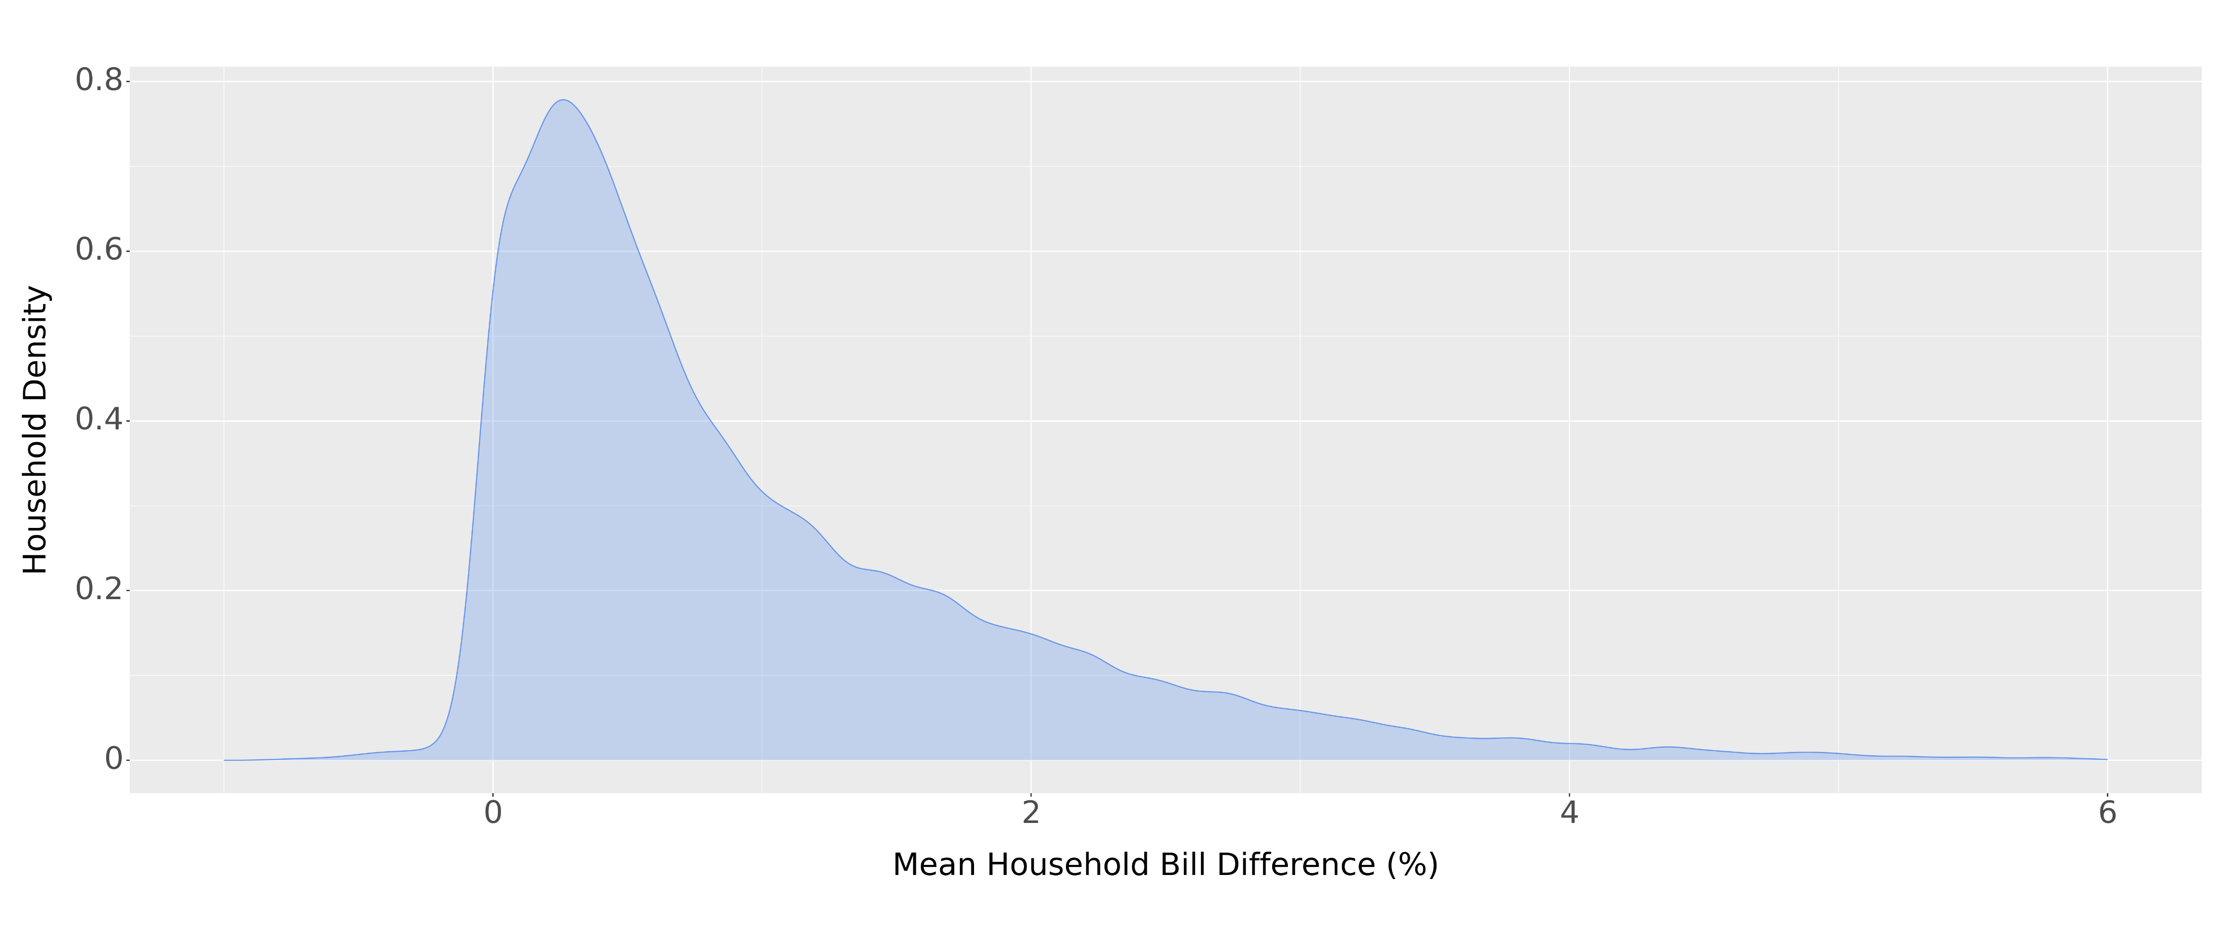
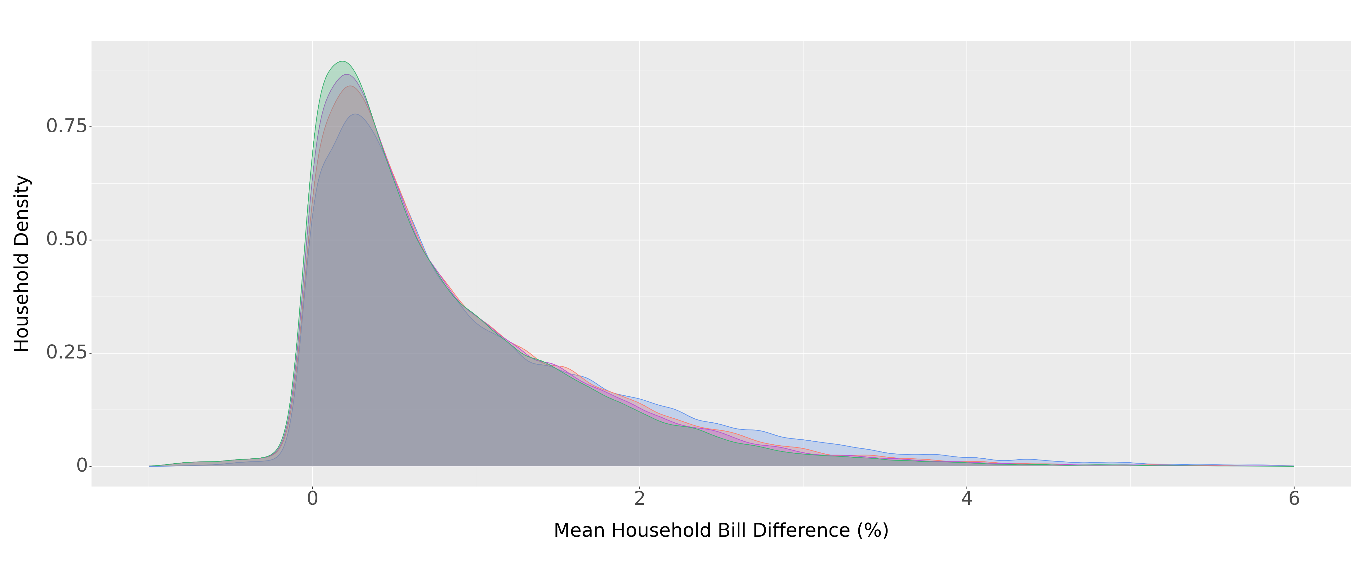
How to Win: Consumption Shifting (NEM)
No Response
20% Shift to Mid-Peak
10% Shift to Mid-Peak & Off-Peak
20% Shift to Off-Peak

Slide 25
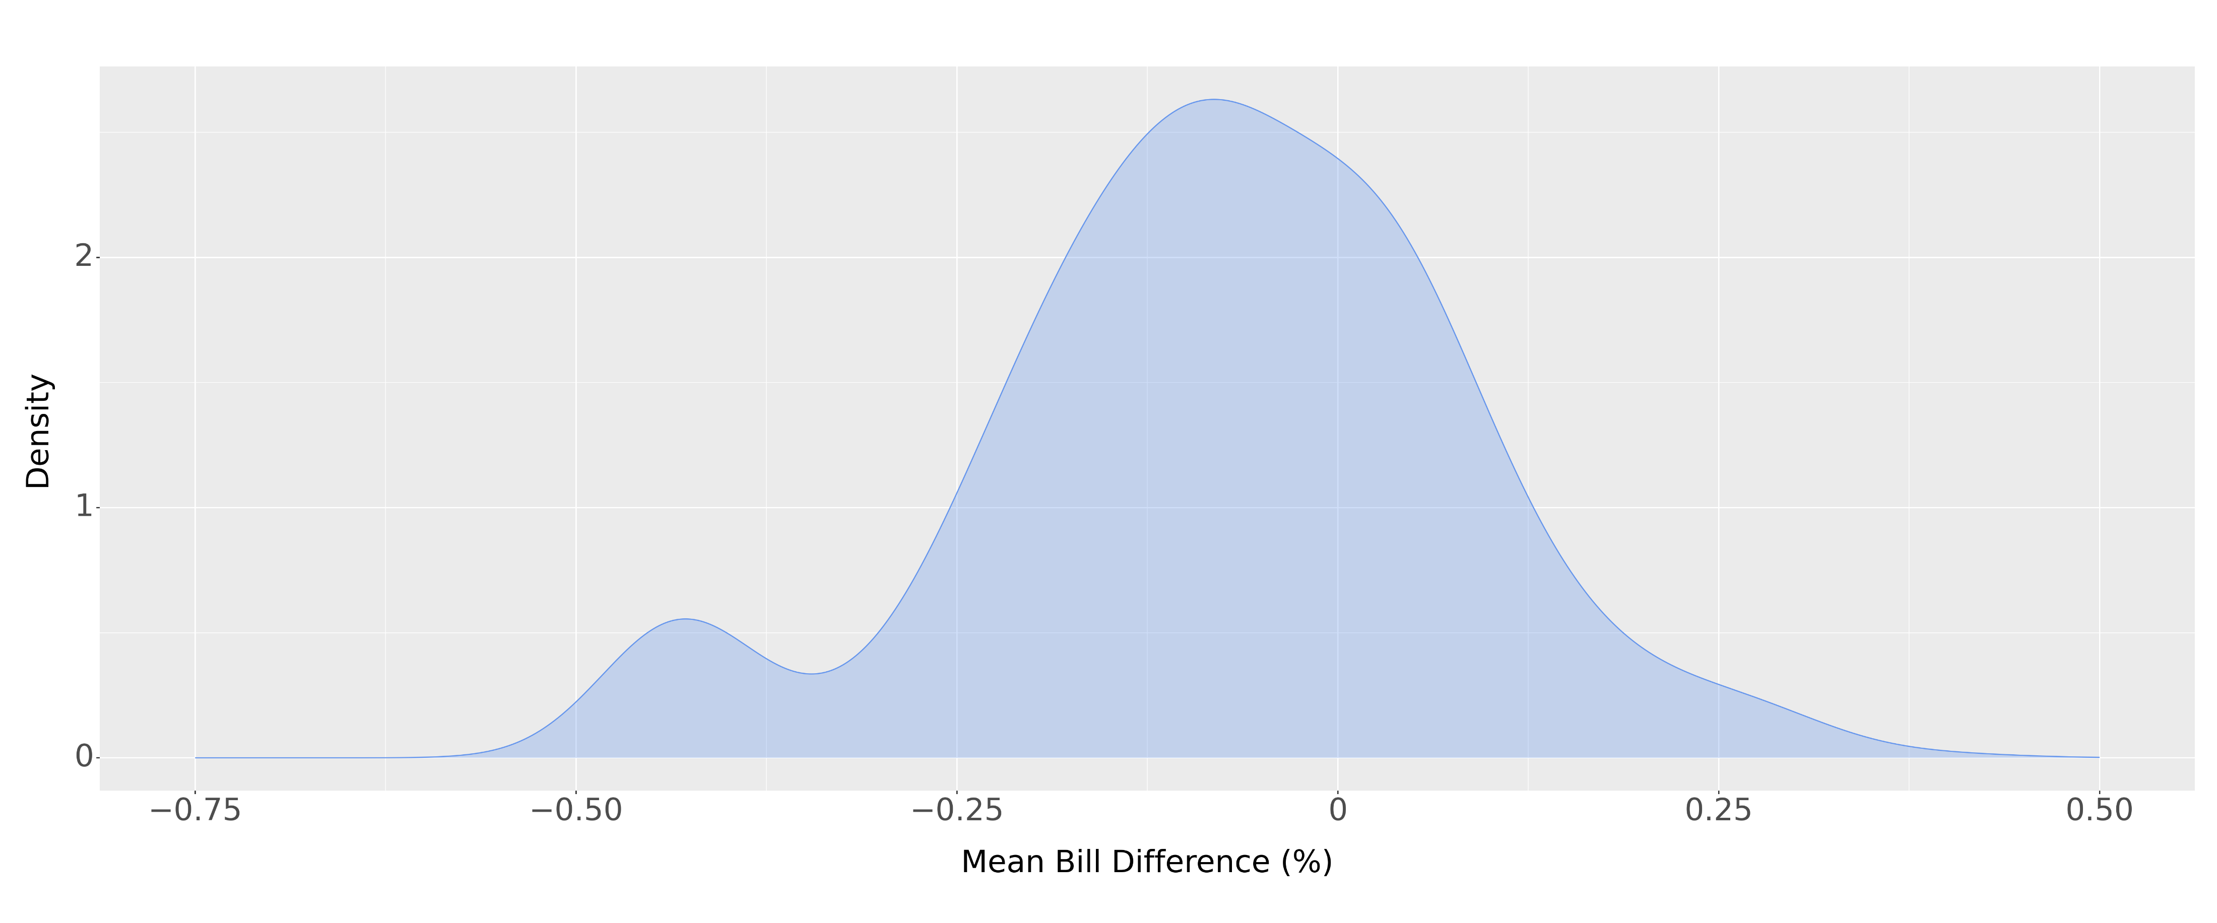
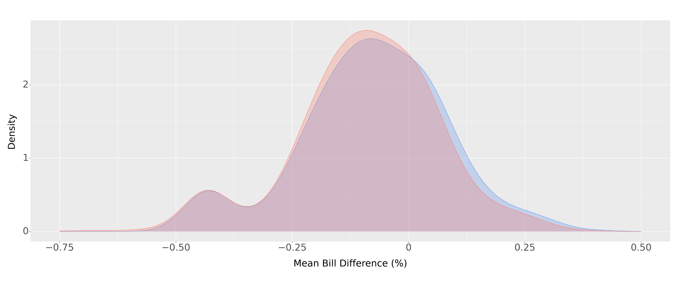
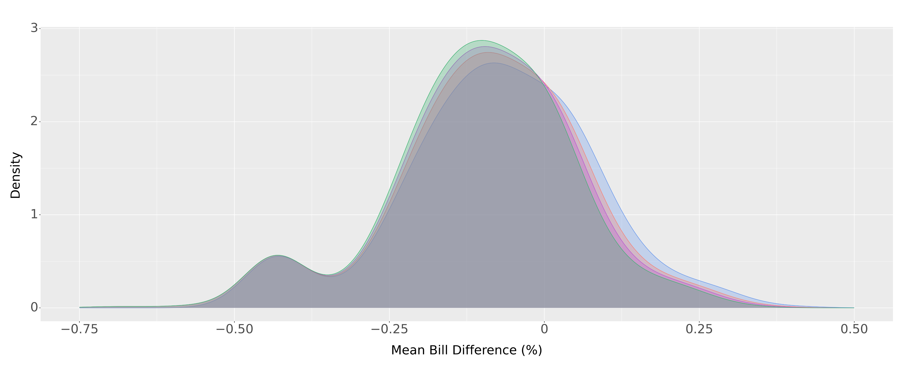
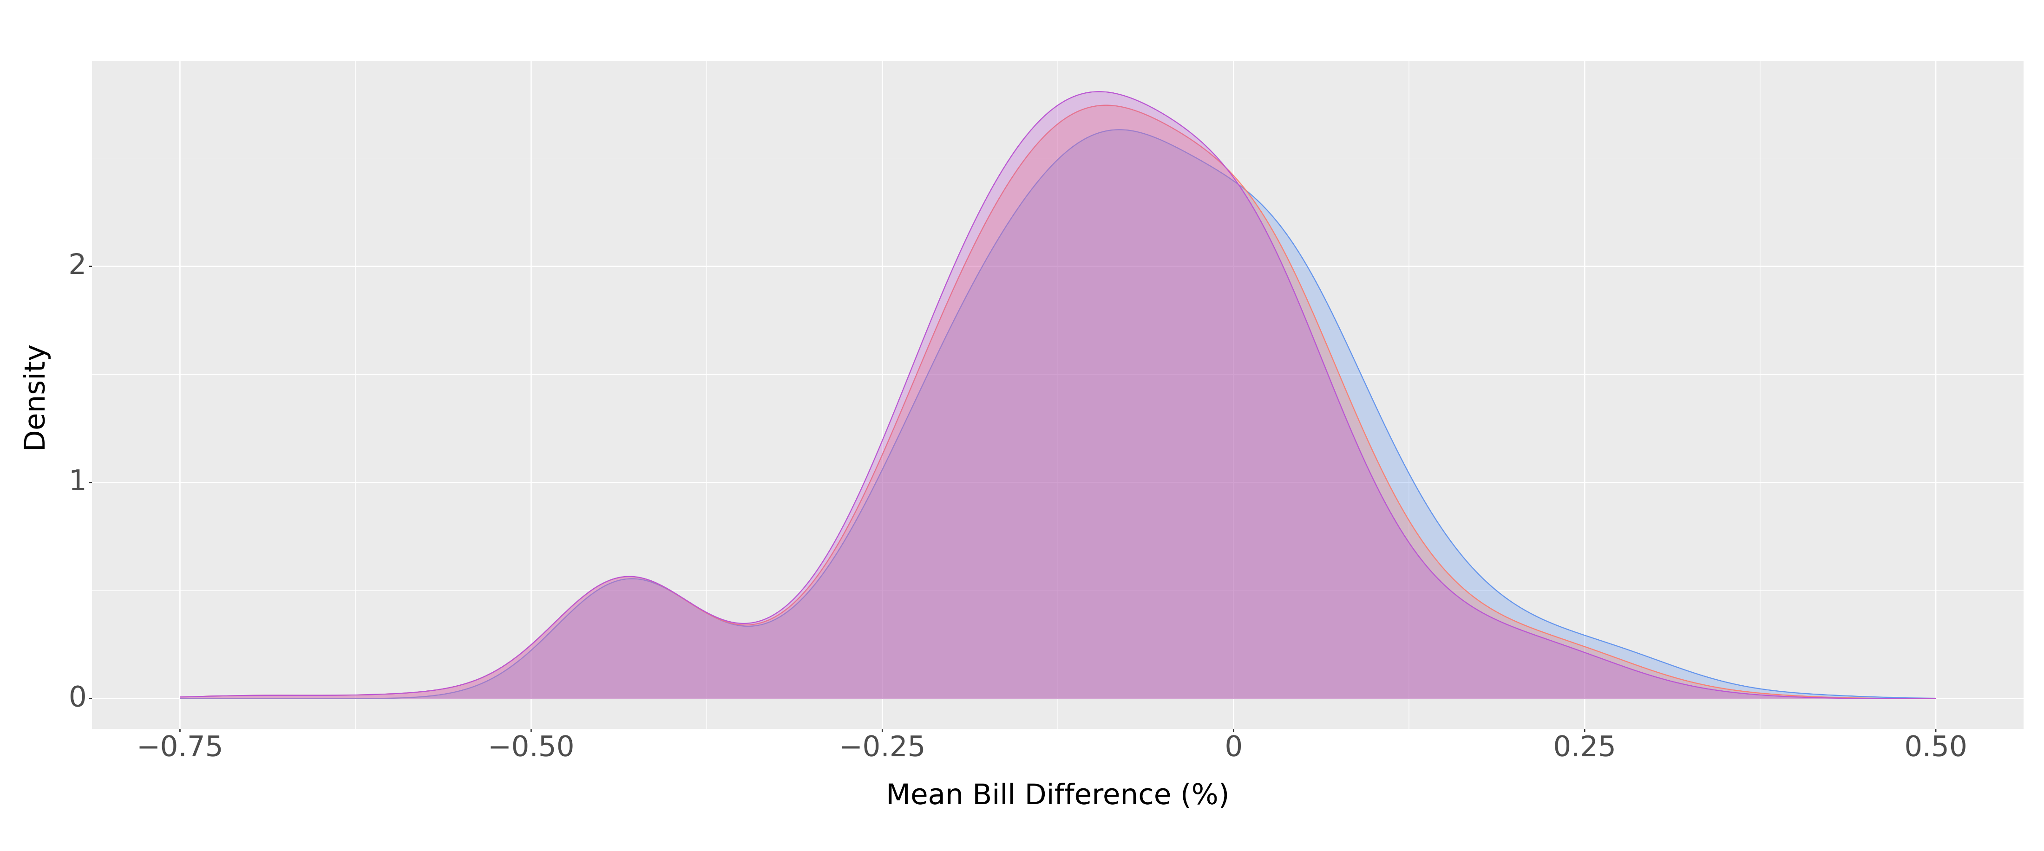
How to Win: Consumption Shifting (Small Commercial)
No Response
20% Shift to Mid-Peak
10% Shift to Mid-Peak & Off-Peak
20% Shift to Off-Peak

Slide 26
How to win: Battery Bonus Program
Tesla Powerwall
13.5 kWh capacity
$15,000 estimated cost of unit & installation
$11,175 post one-time incentive
~ $3 daily fixed cost
Total cost split across the 10-year life span (warranty) of the unit
Battery Bonus Incentives
$3,825 one-time incentive
Monthly bill credit
NEM customers always receive the respective retail rate
Non-NEM customers receive the respective retail rate for the first 3 years then receive the export credit of their respective PV program.
We visualize the impact during the first 3 years.
$5 per KW monthly peak capacity payment for the 10-year program duration.
Our current calculations omit this bill credit as it is unclear what this value currently is.

Slide 27
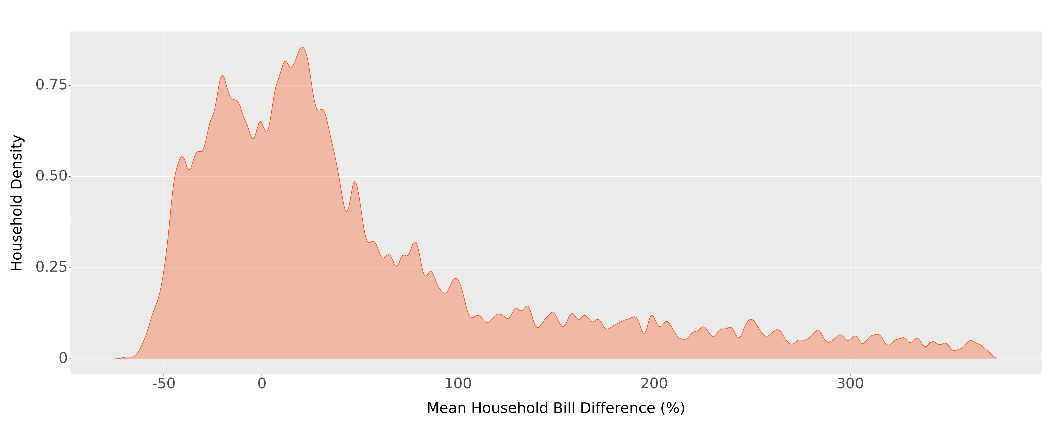
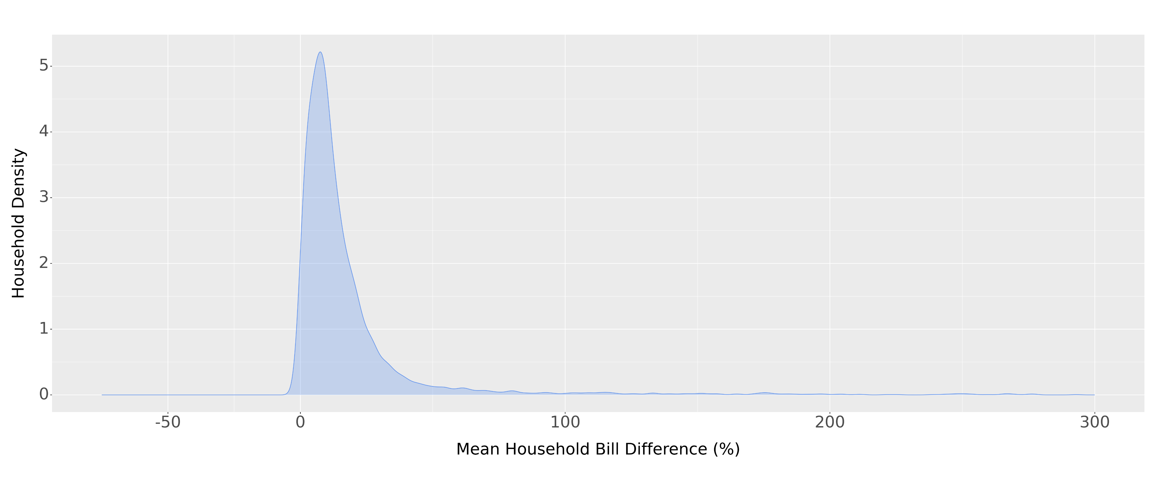
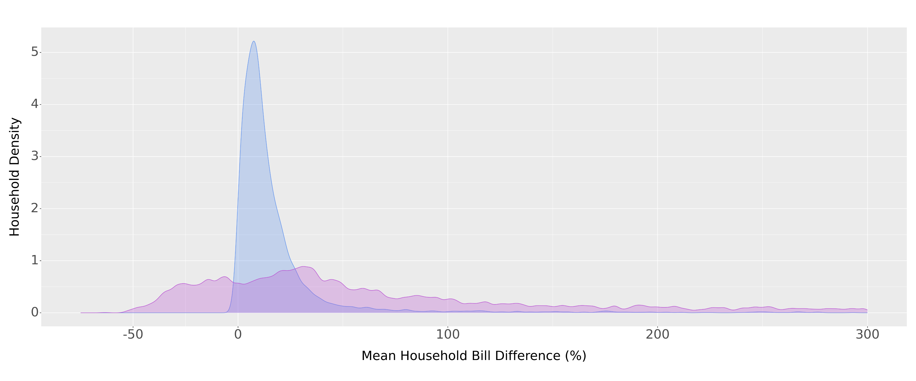
How to win: Battery Bonus (Other PV Losers)
TOU vs TOU w/ Battery
Current Rate vs TOU
Current Rate vs TOU
Current Rate vs TOU w/ Battery

Slide 28
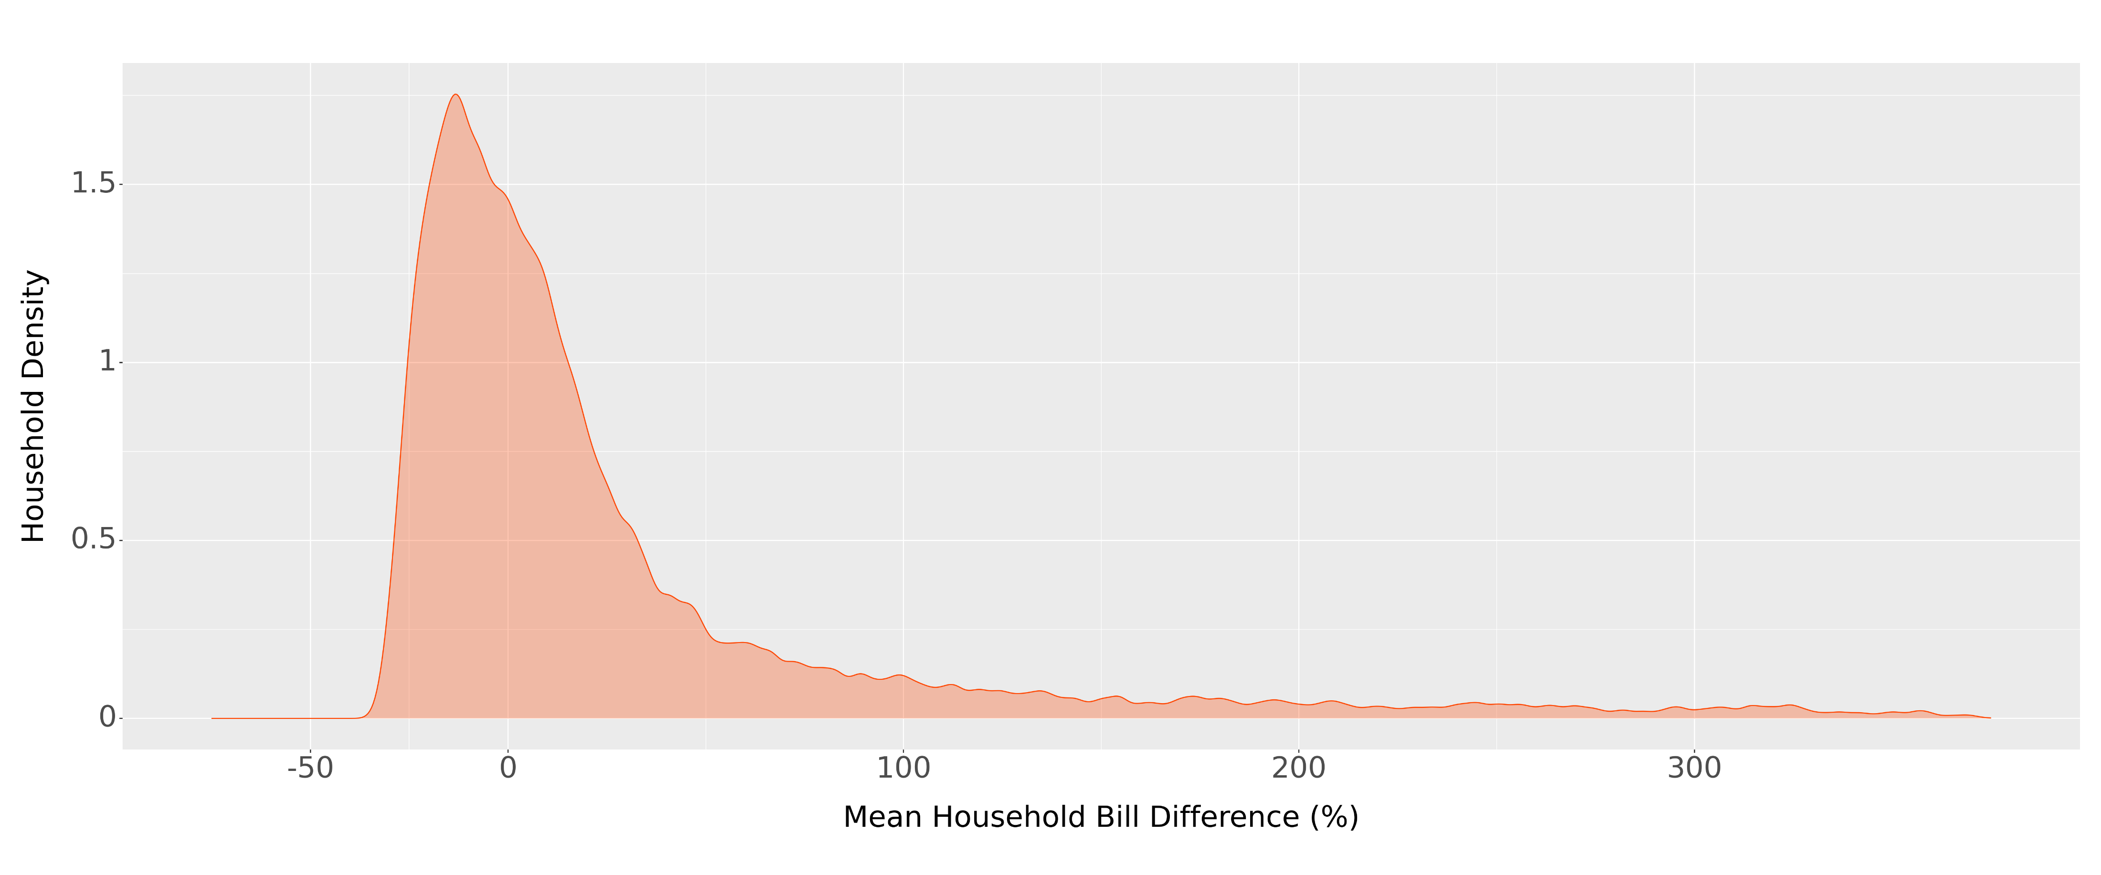
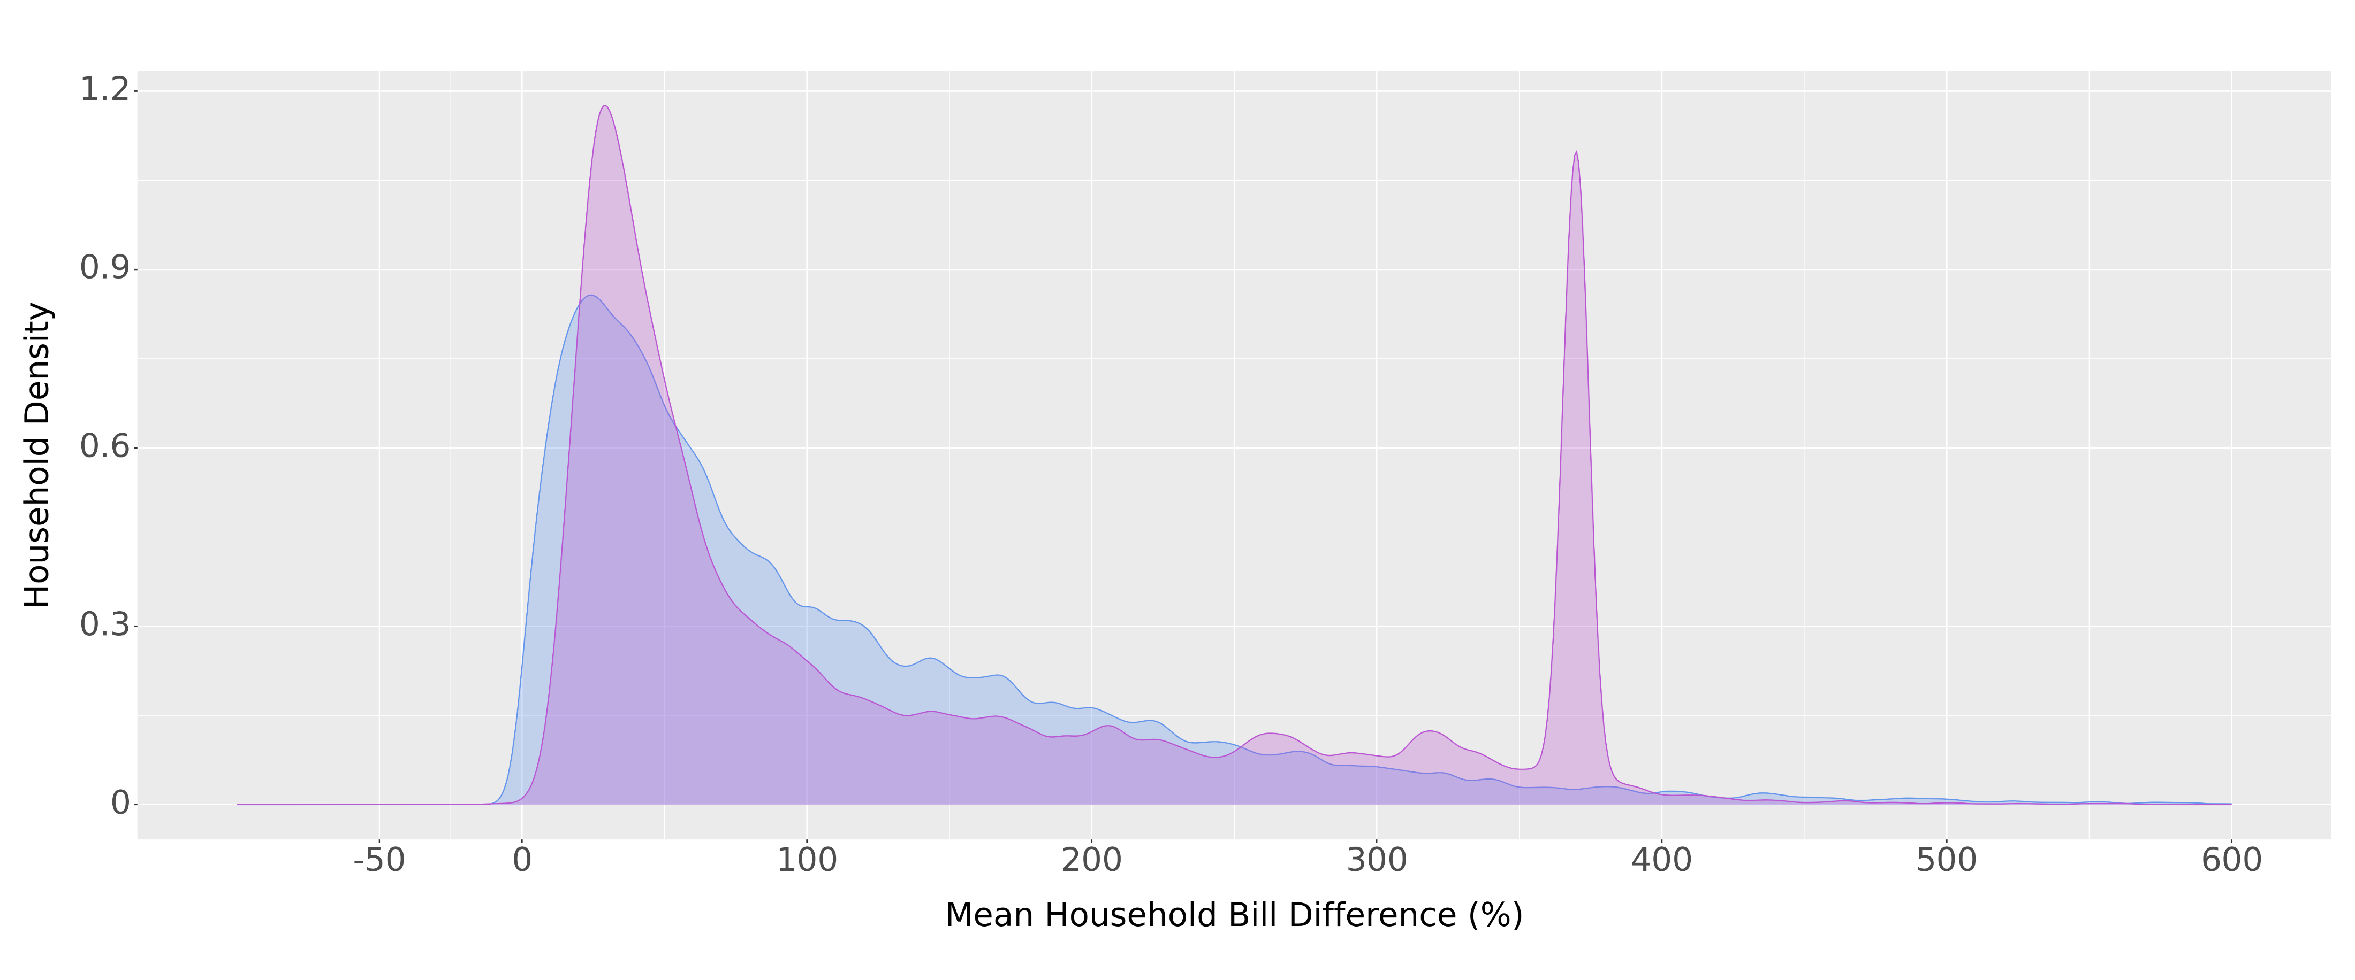
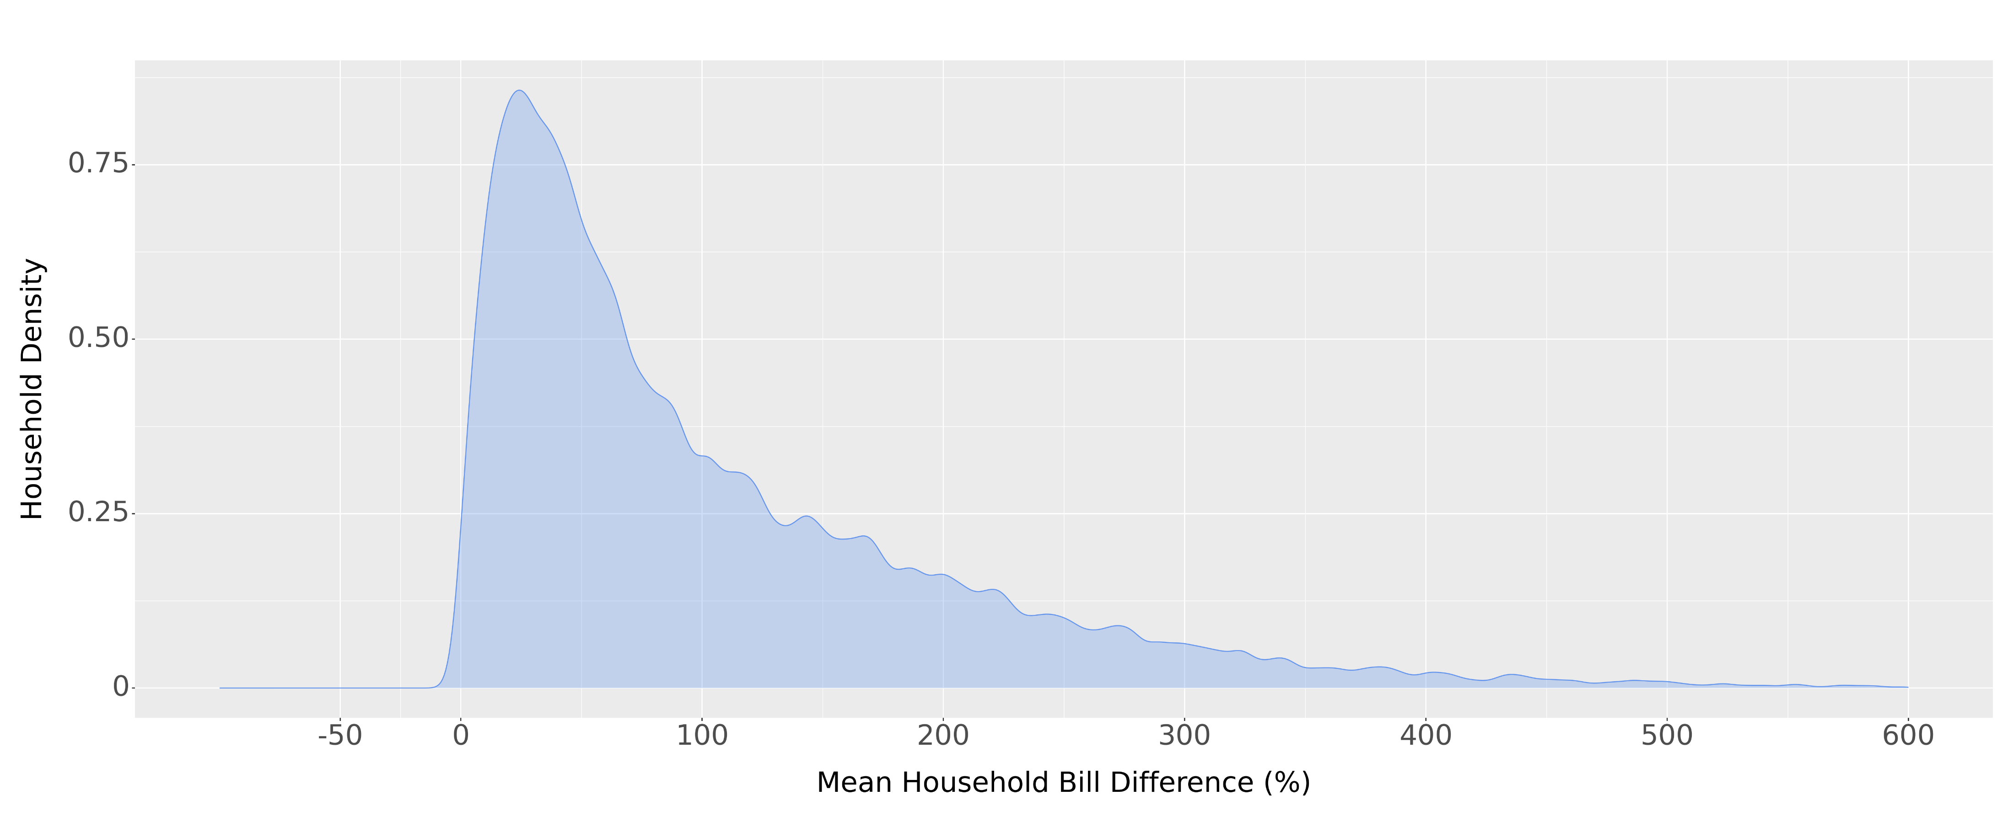
How to win: Battery Bonus (NEM Losers)
TOU vs TOU w/ Battery
Current Rate vs TOU
Current Rate vs TOU
Current Rate vs TOU w/ Battery

Slide 29
Conclusion
Winners & Losers
No Response
53% of non-PV and 96% of PV households will see an increase in their monthly bill
Consumption Shifting
16% of non-PV and 82% of PV households will see an increase in their monthly bill
Battery Bonus
18% of CGS, CGS+, SE, & CSS customers transition from losing to winning under TOU
0.0002% of NEM customers transition from losing to winning under TOU
Shift & Save Sample
Why sample so many PV households?
Is it ethical to nudge these households into a program that isn’t in their best interest?

